Slide 1
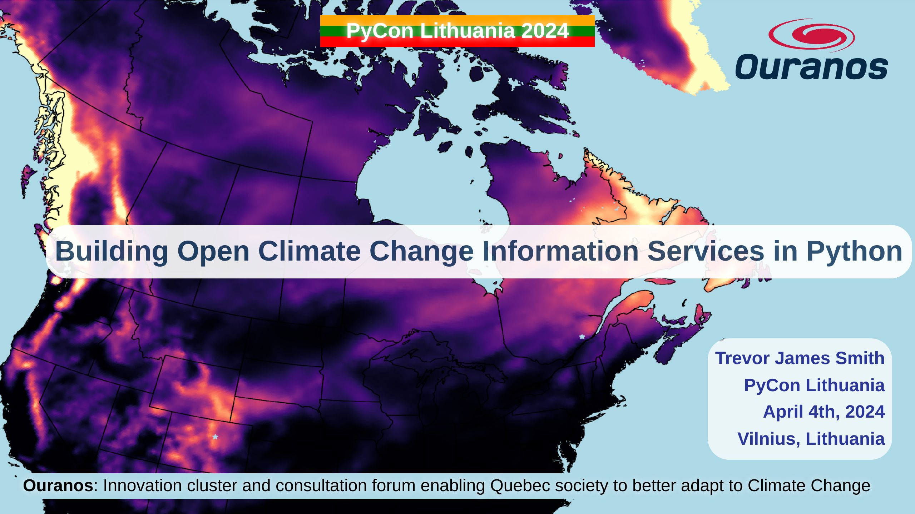
Notes:
Thanks so much to PyCon Lithuania and the organizers for this fantastic conference so far. Today, I’m talking about how we've been using Python to build our open source offerings to better equip researchers interested in climate science.

Slide 2
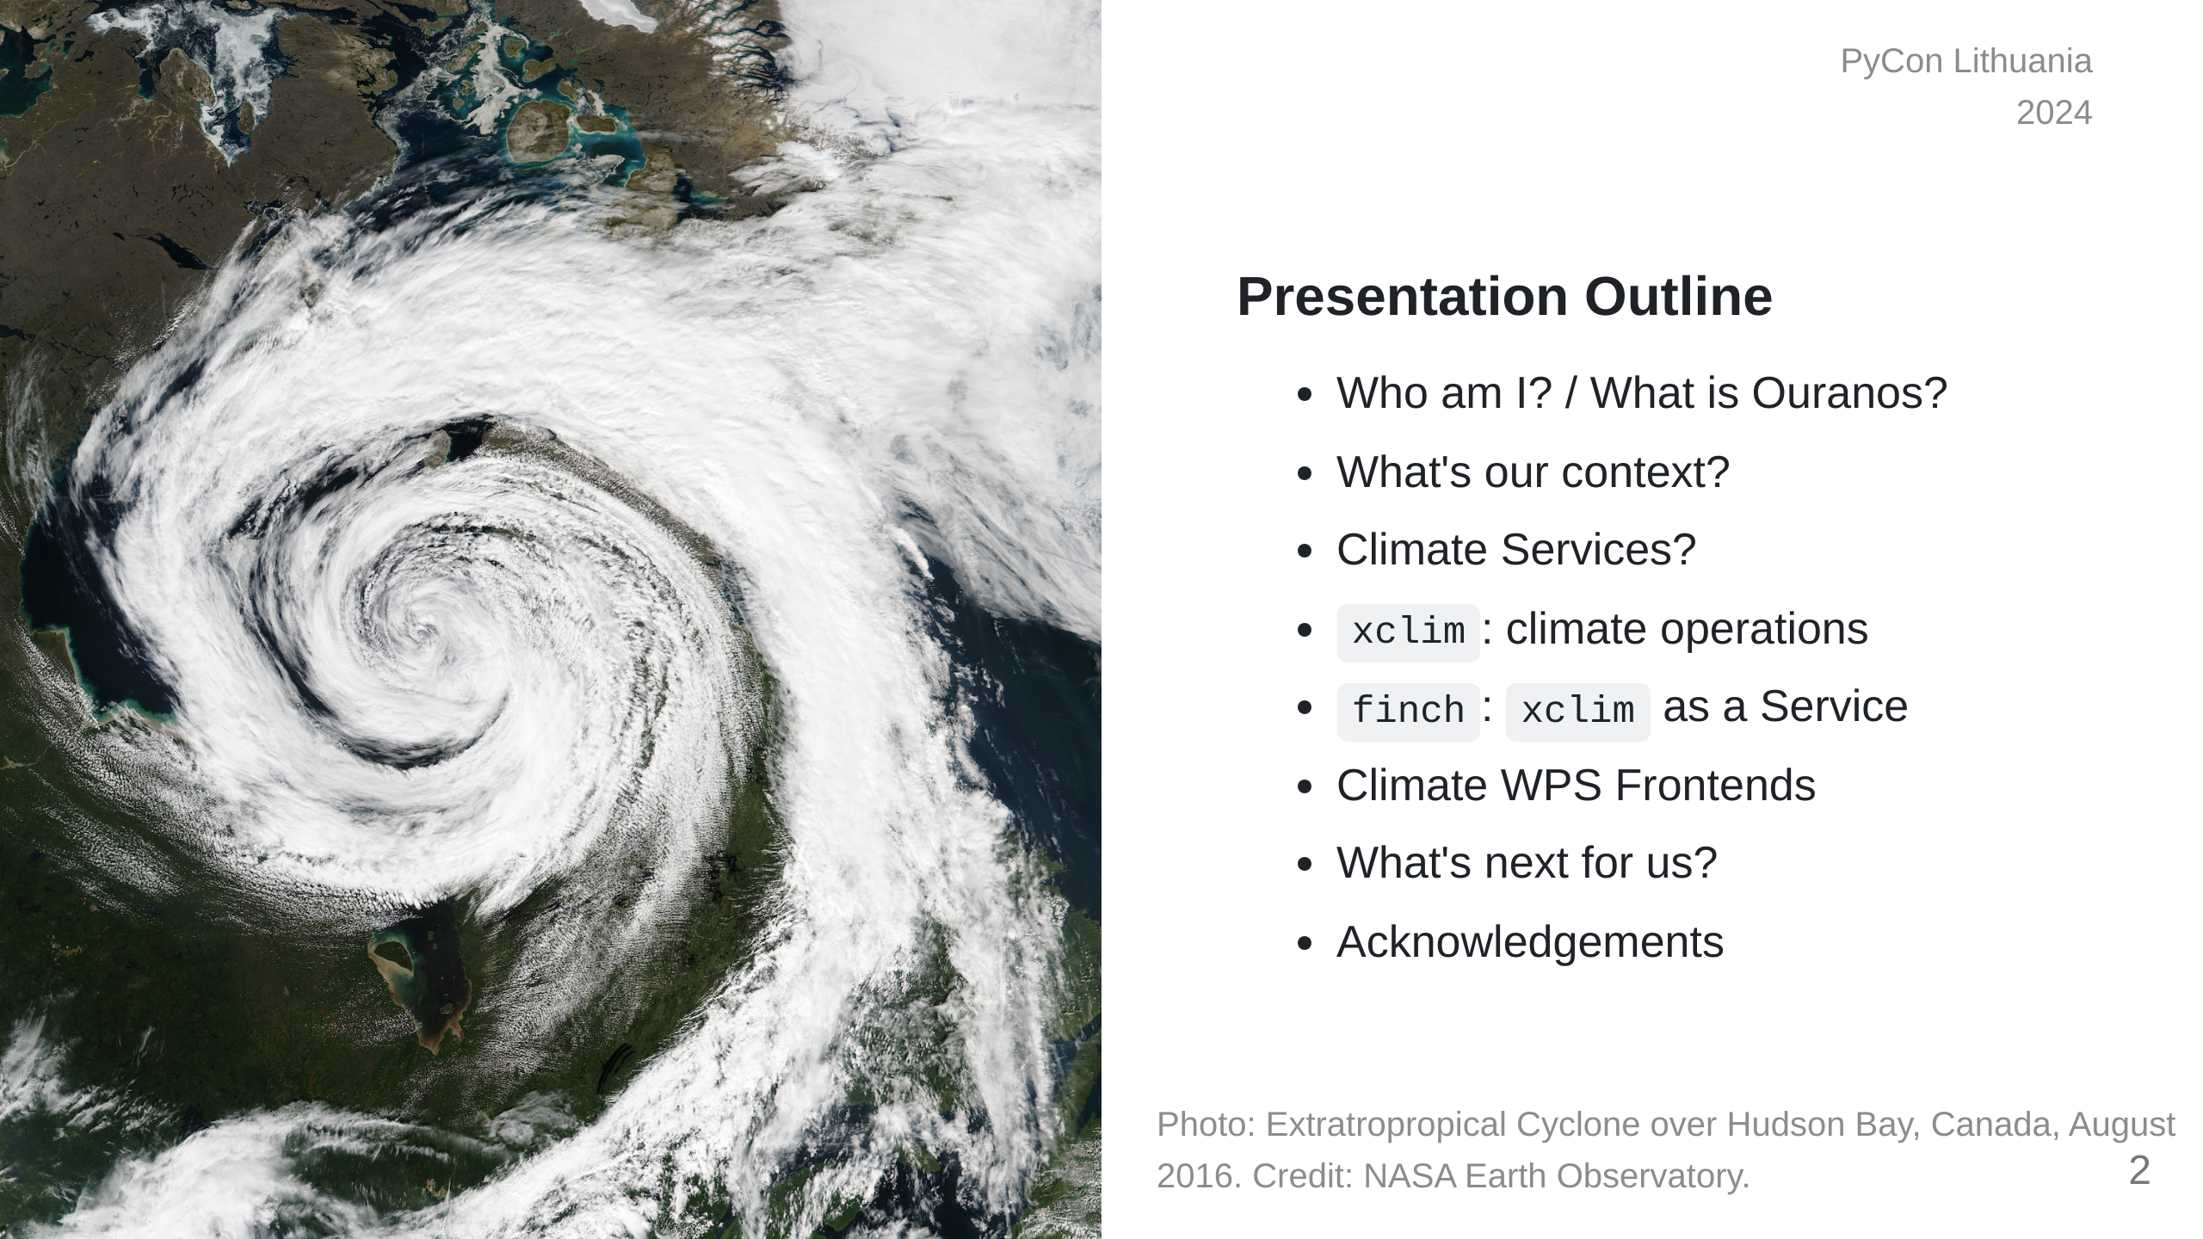
Notes:
This presentation is going to start by providing some context on the

Slide 3


Slide 4
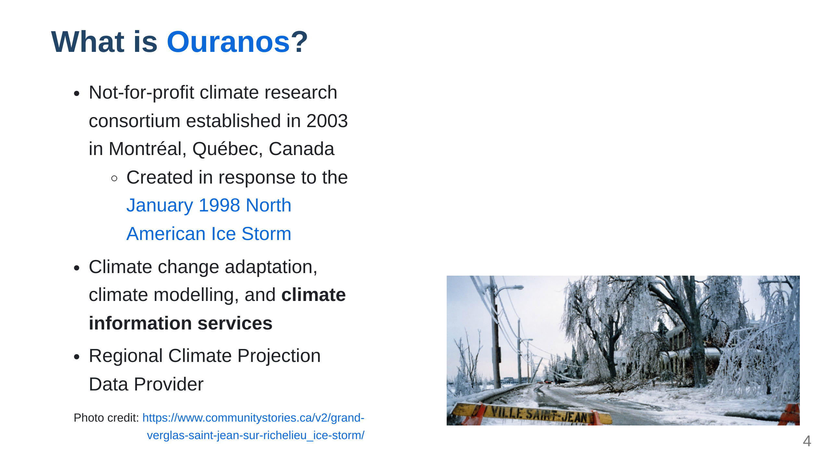

Slide 5
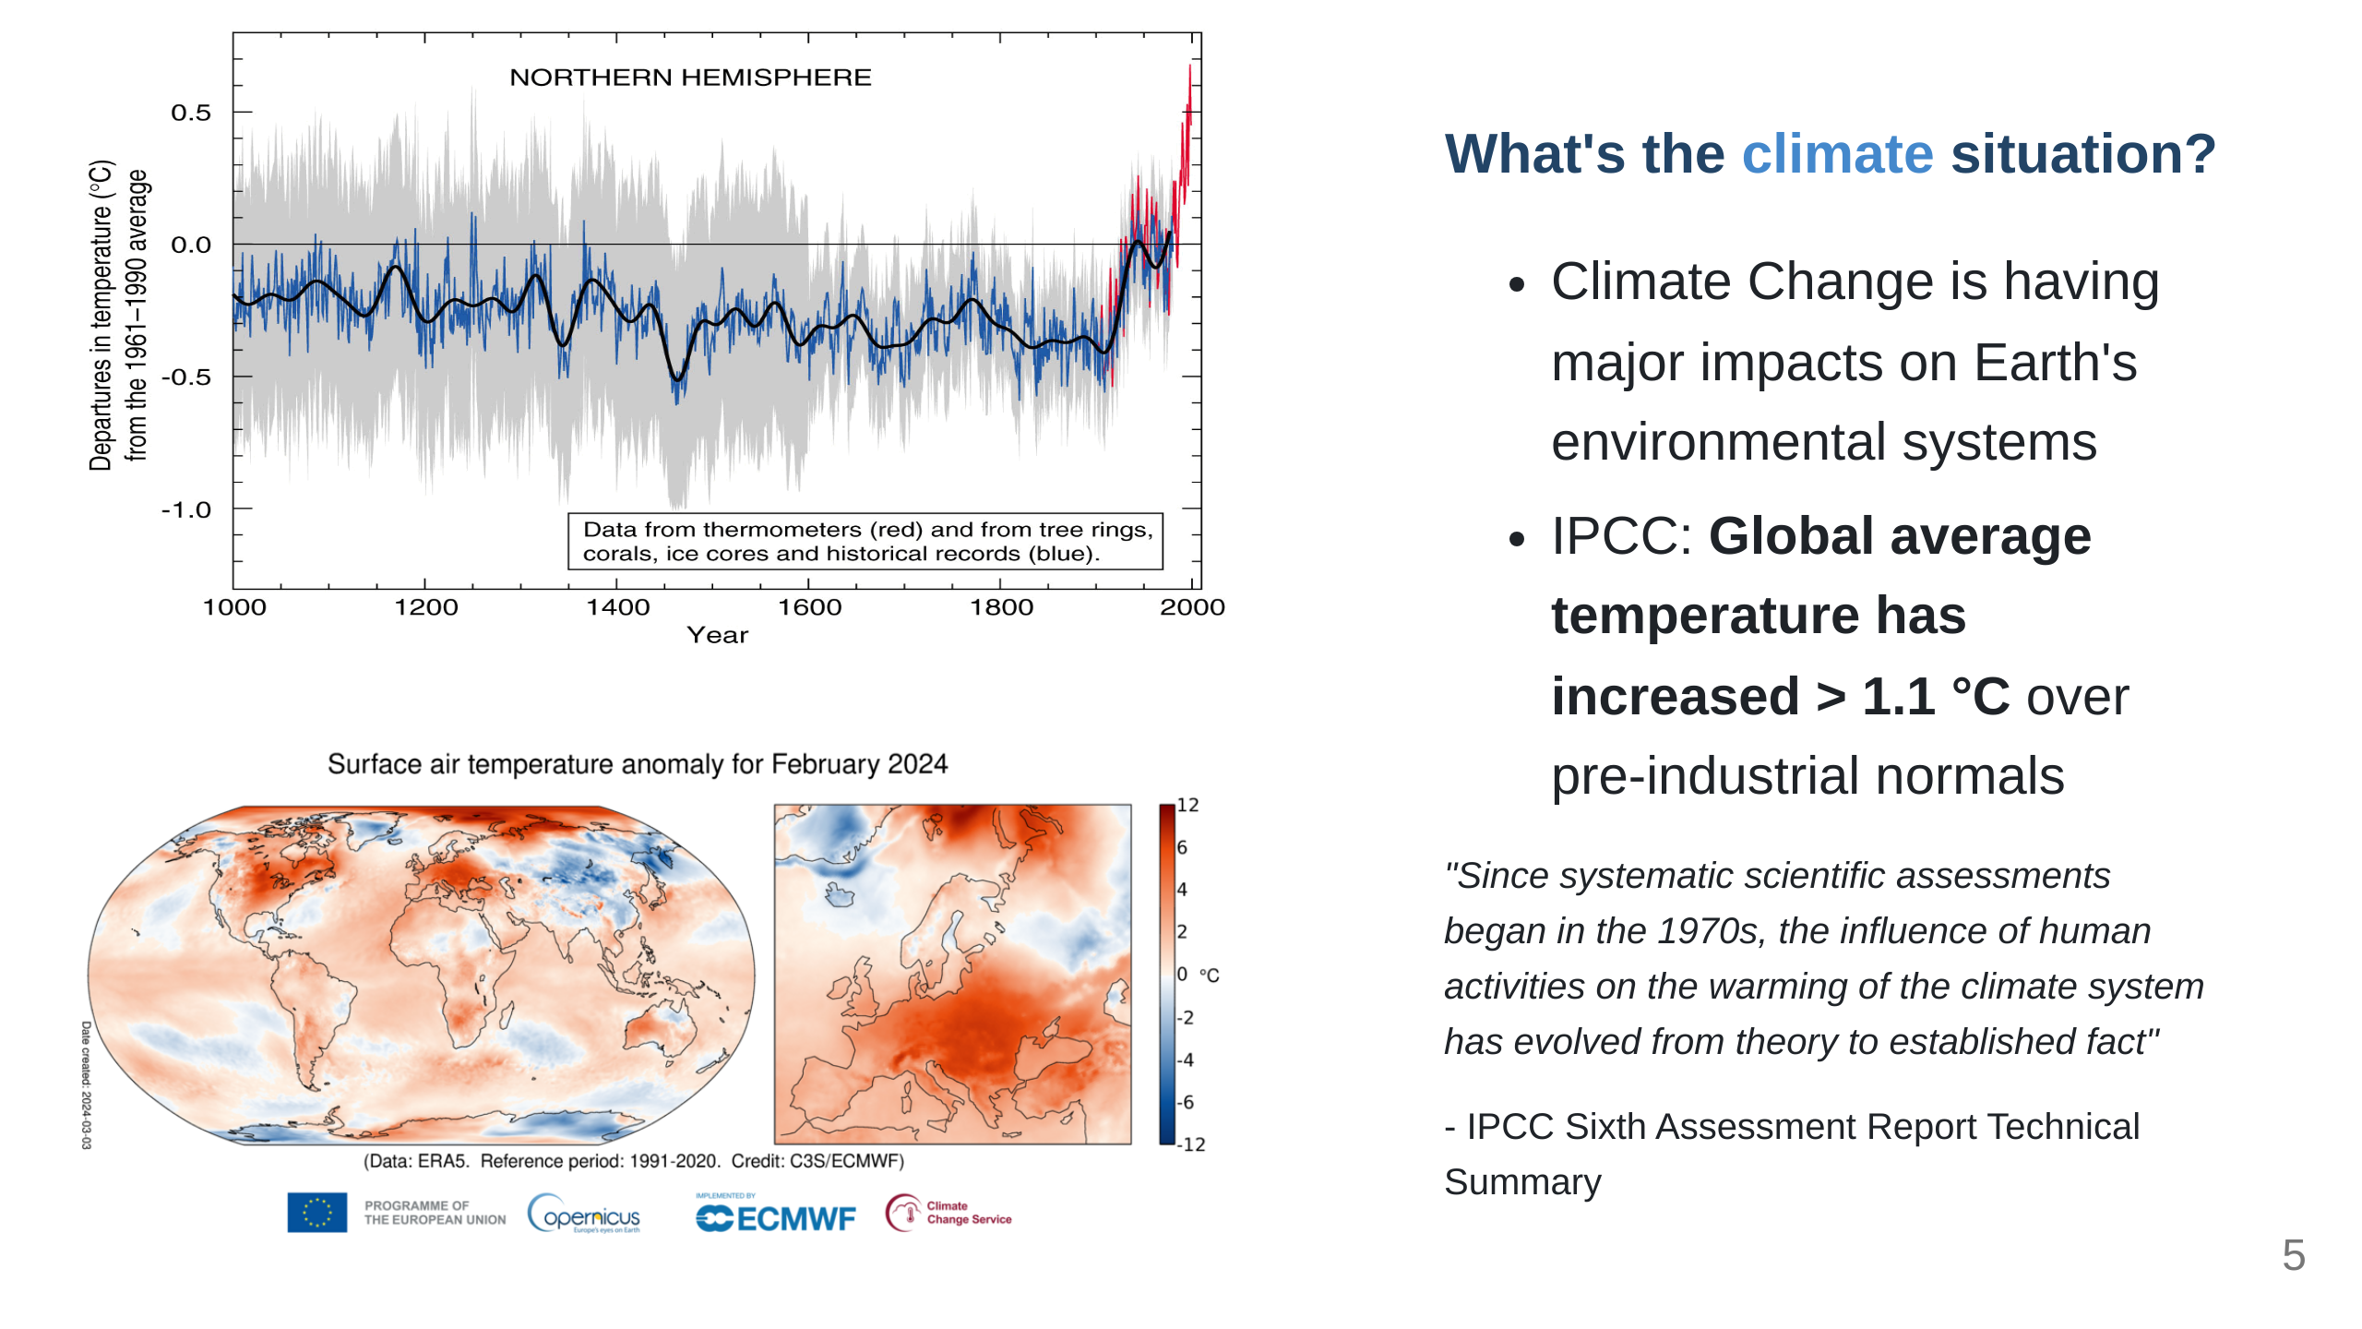

Slide 6
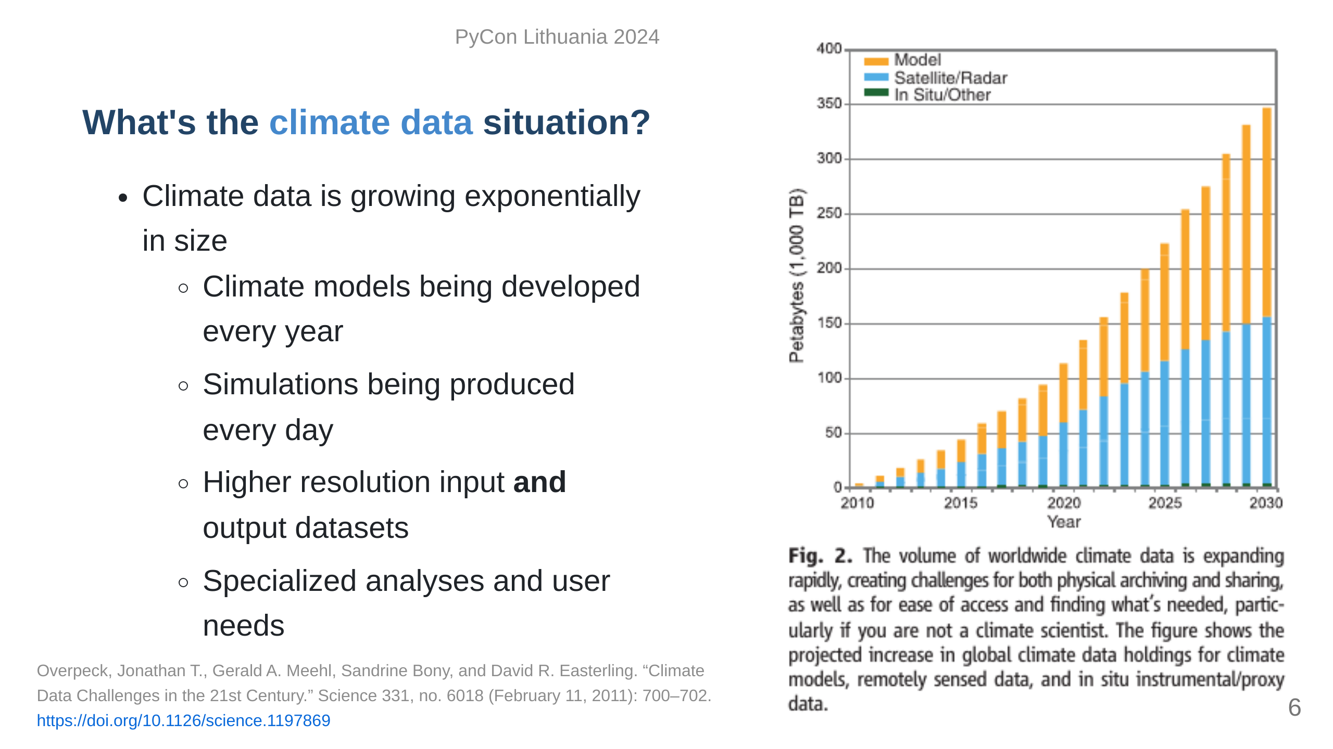

Slide 7
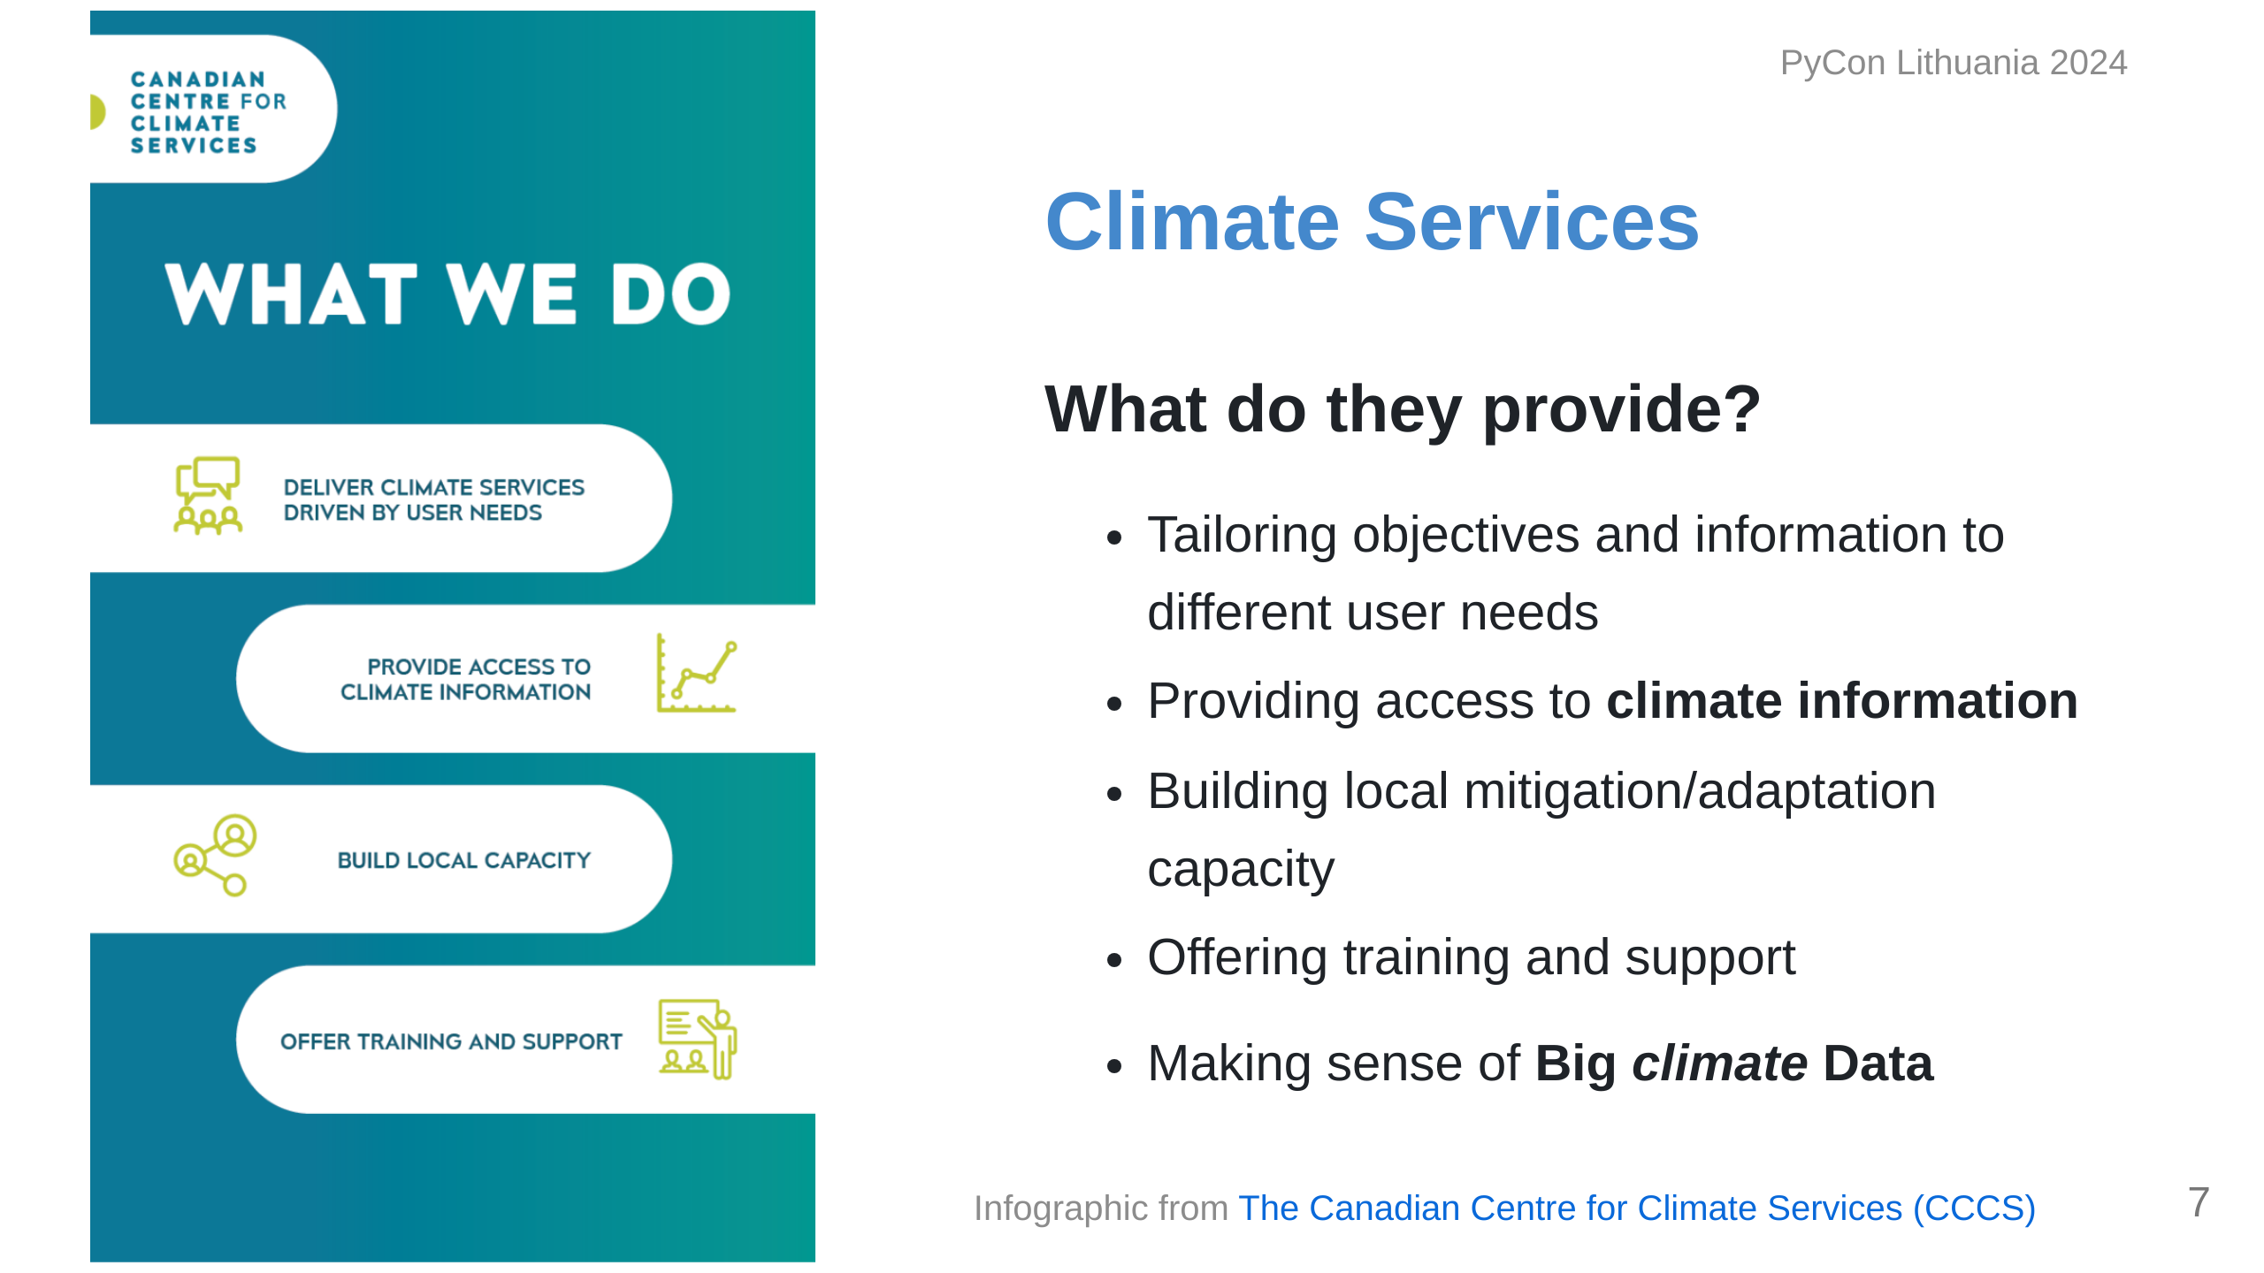

Slide 8
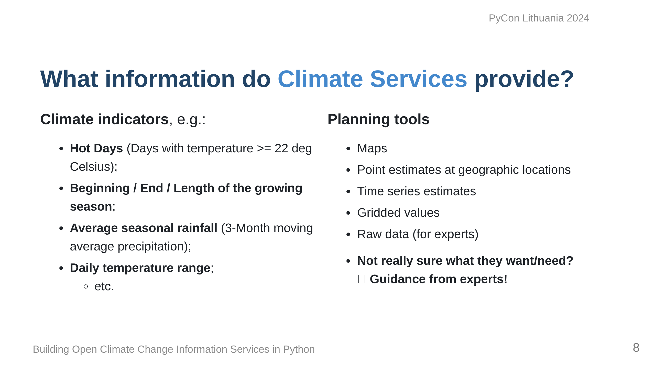

Slide 9
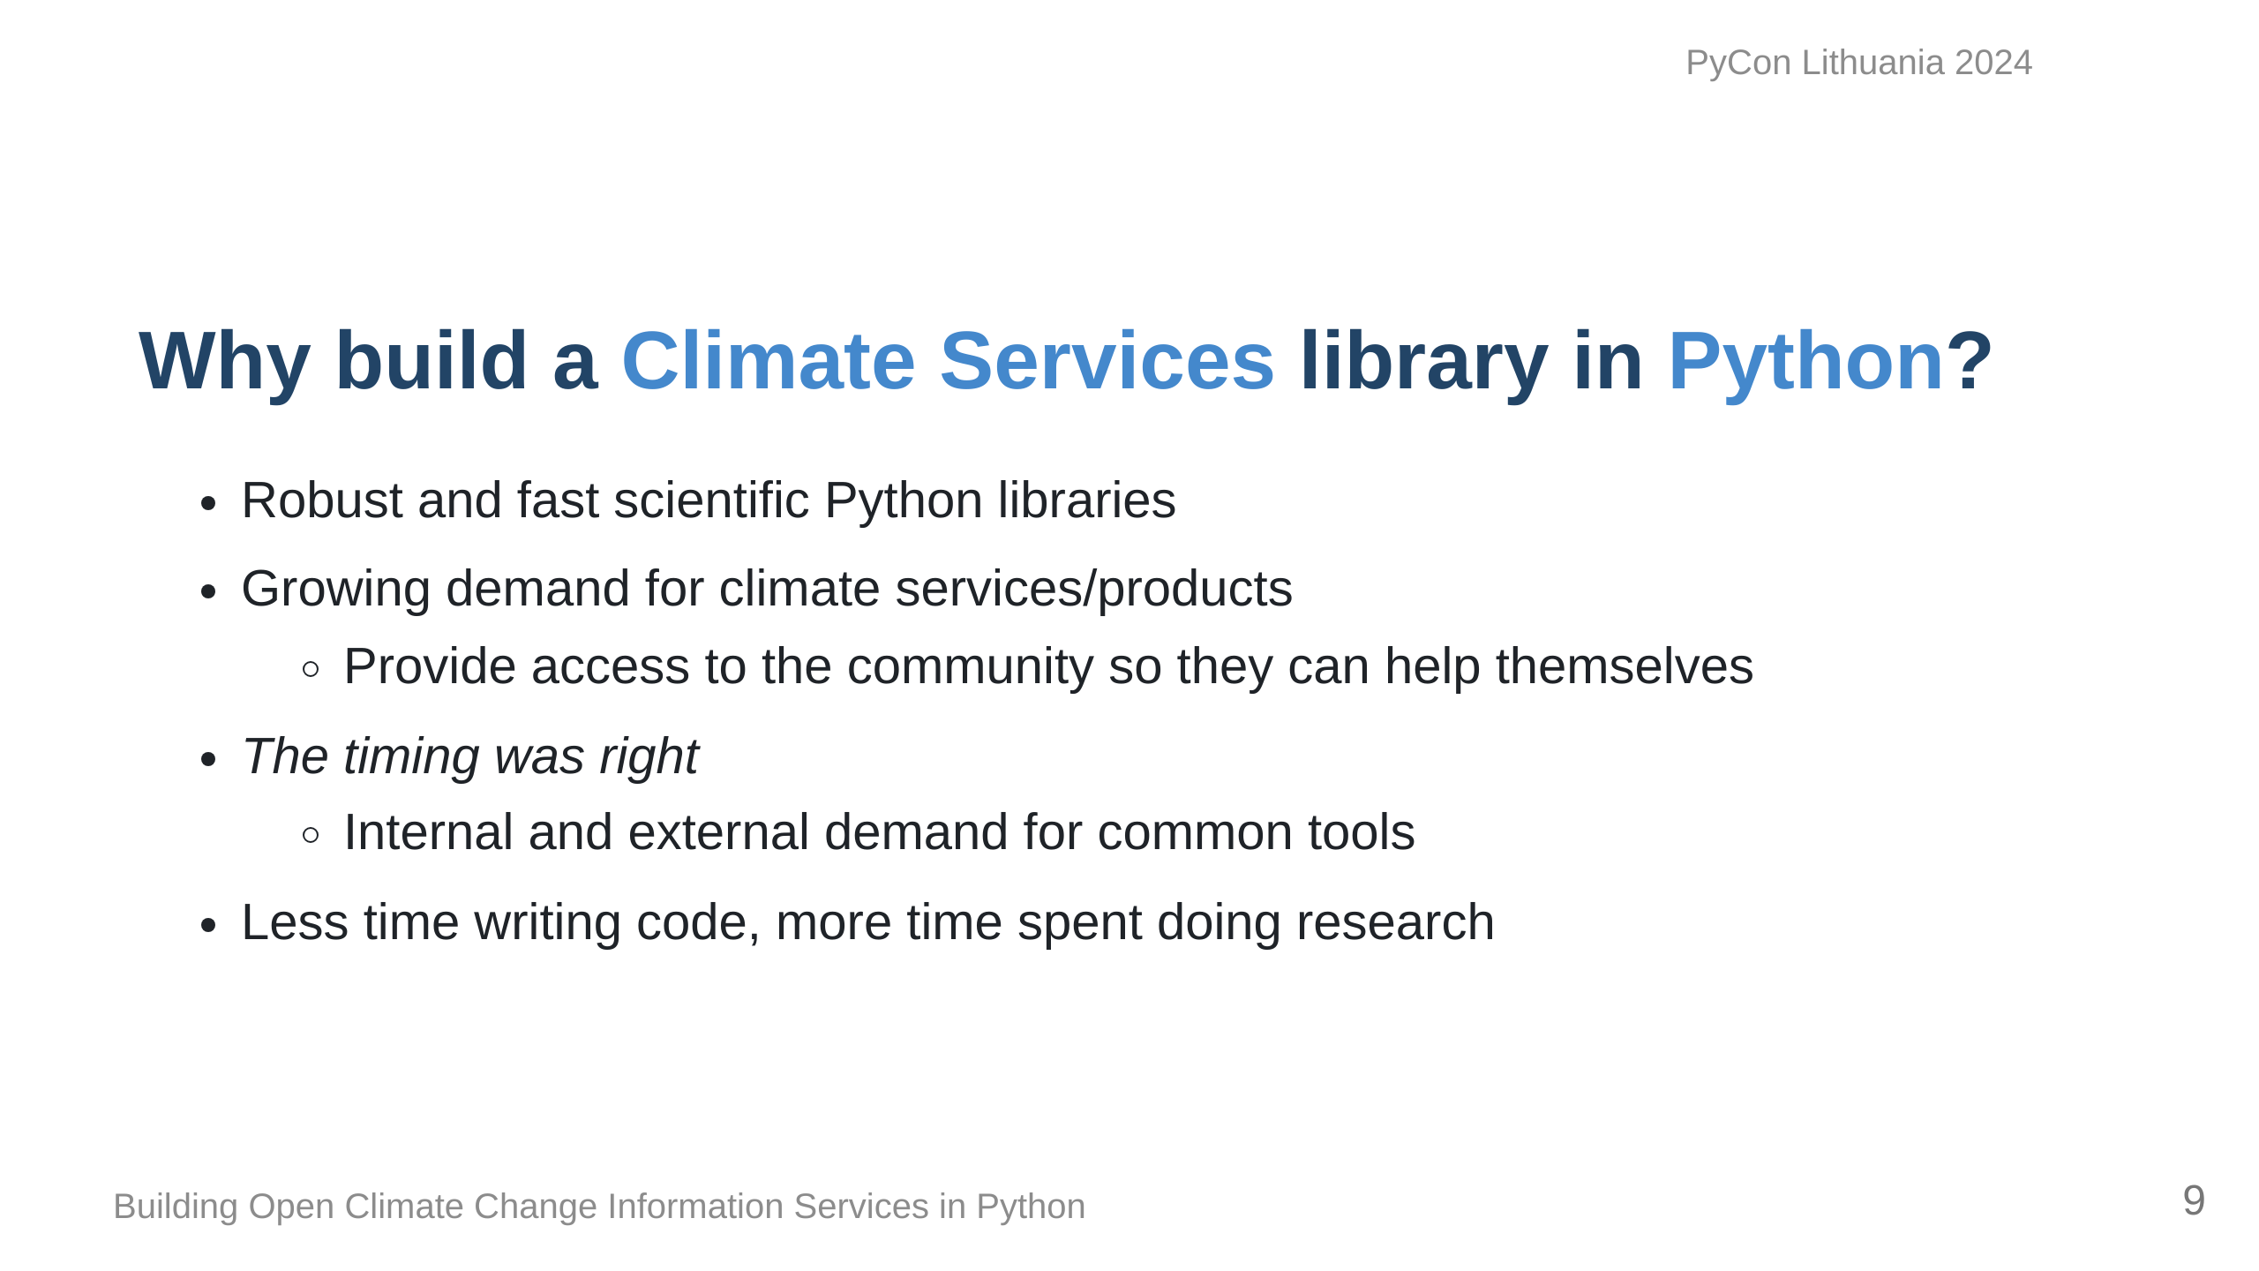

Slide 10
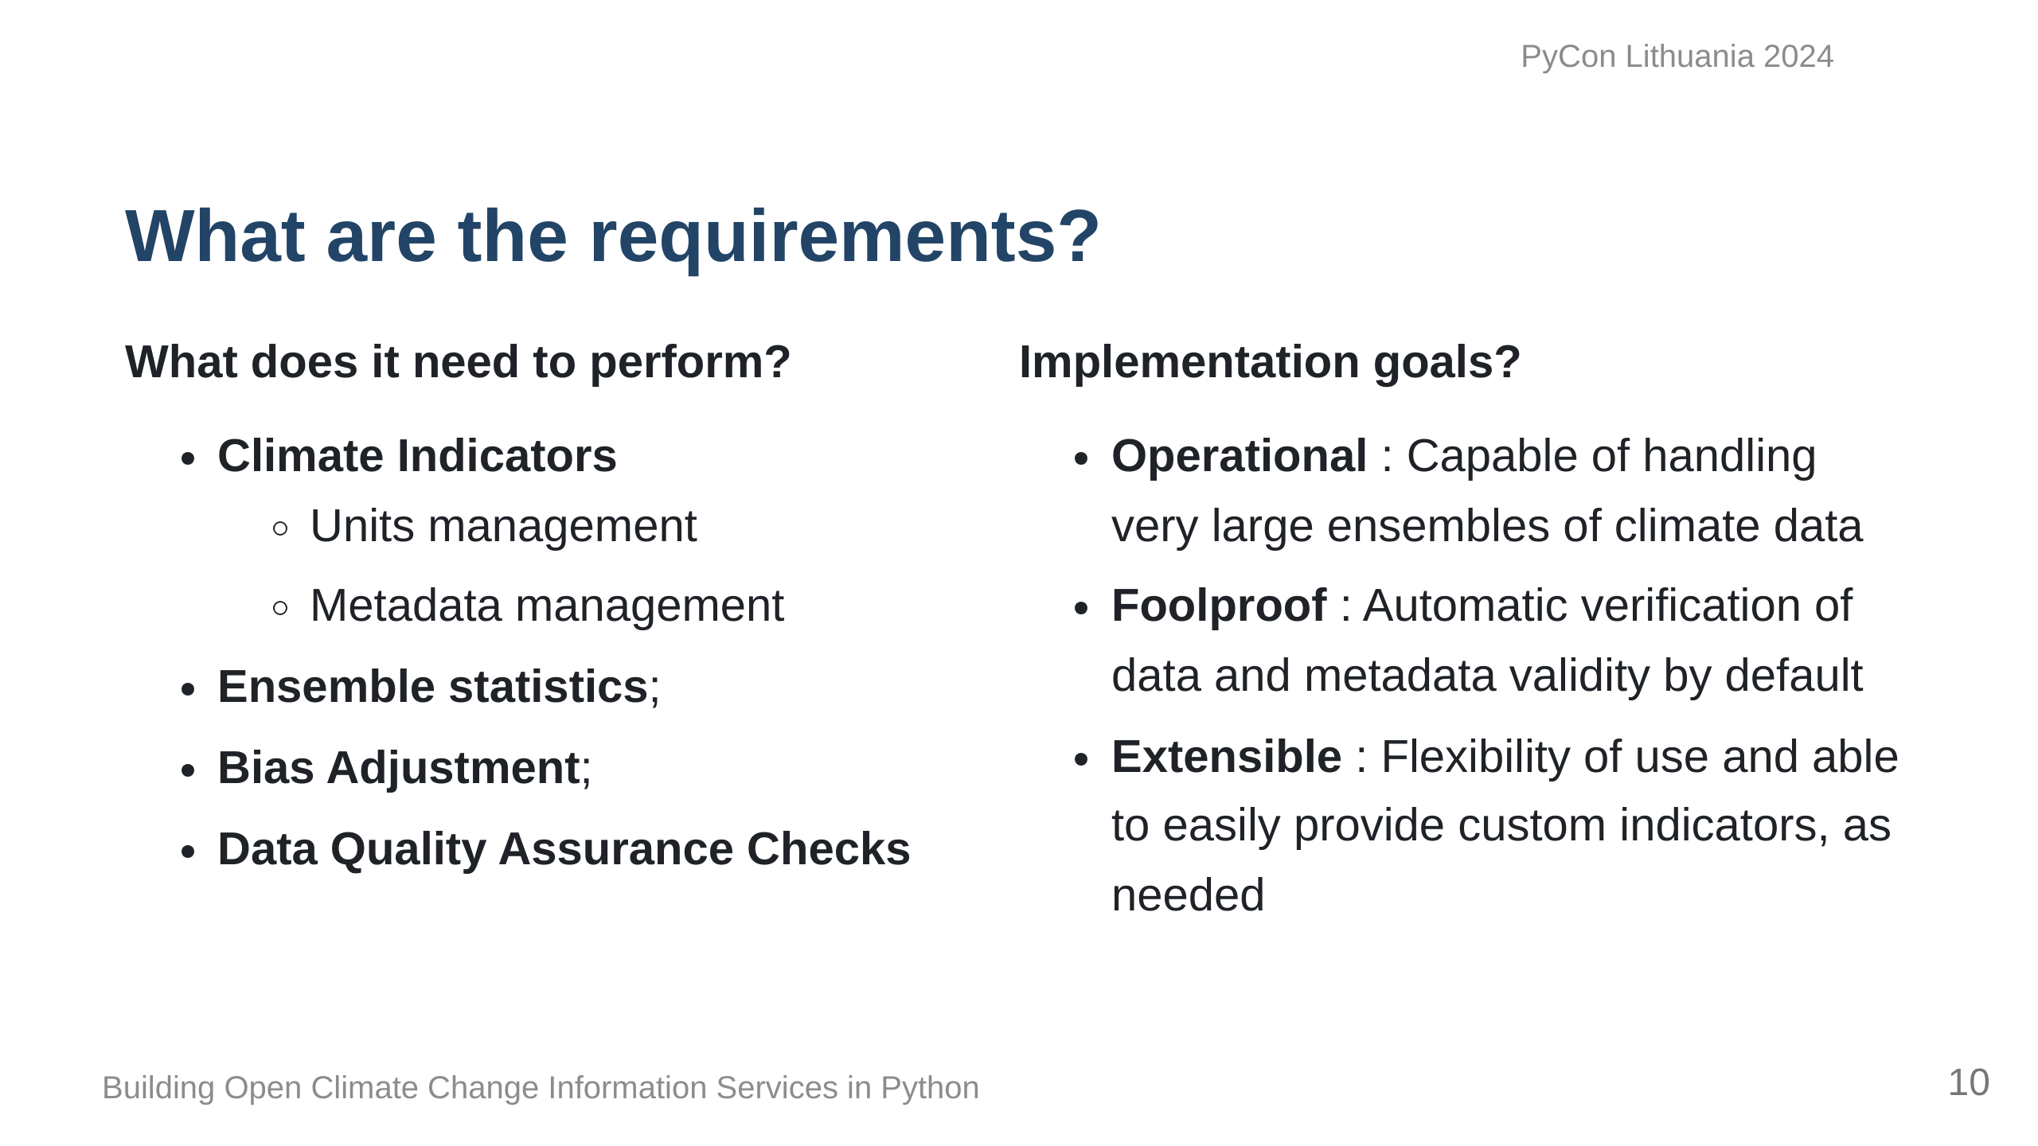

Slide 11
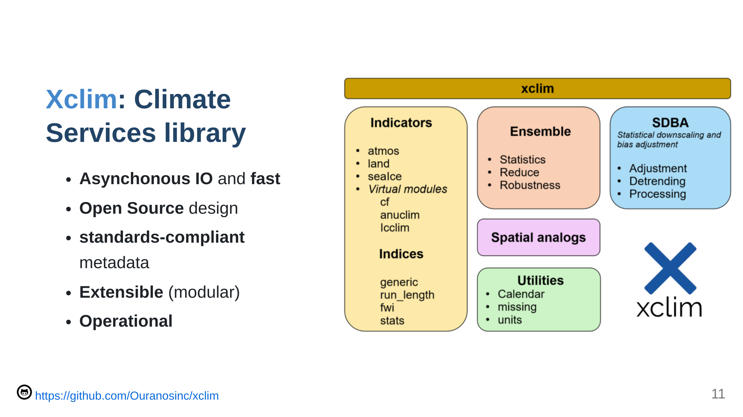

Slide 12
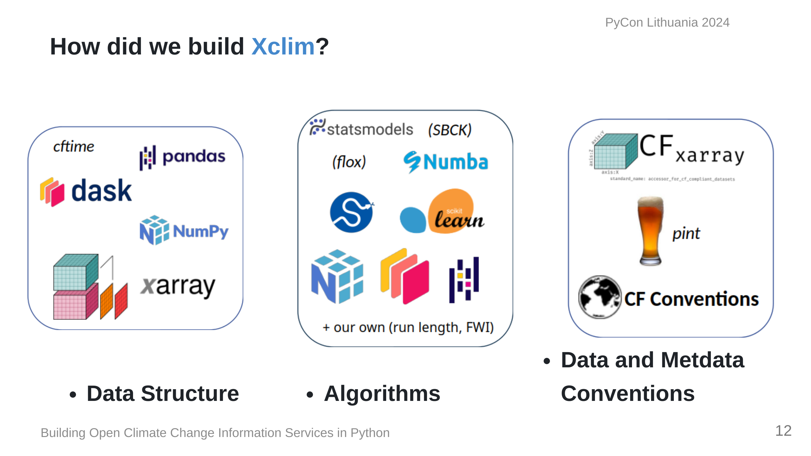
Notes:
We based our data structures on several Open Source scientific Python libraries, namely, Pandas, Numpy and Xarray, ensuring that our code can benefit from the parallelization provided by Dask. Xclim was built to be an operational library and as such, we built our algorithms based on more conventional libraries such as scipy and statsmodels for statistics, scikit-learn for bias-adjustment. Numba provides Just-in-time compilation and Units management and conventions are also key to ensuring that the outputs of operations can be easily used in other applications, and issues such as unit management are handled via libraries dedicated to ensuring that dimensions are always preserved and expected output units are always the same, regardless of inputs.

Slide 13
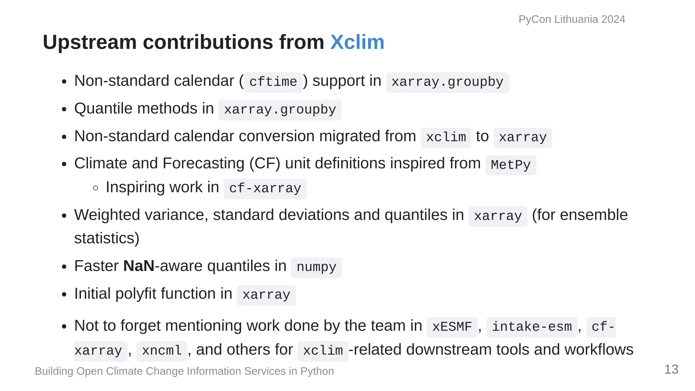

Slide 14
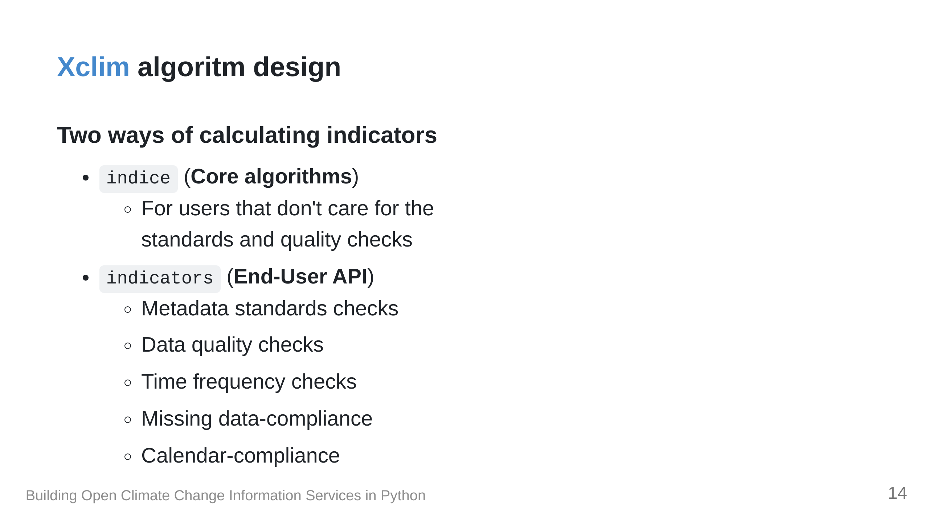

Slide 15
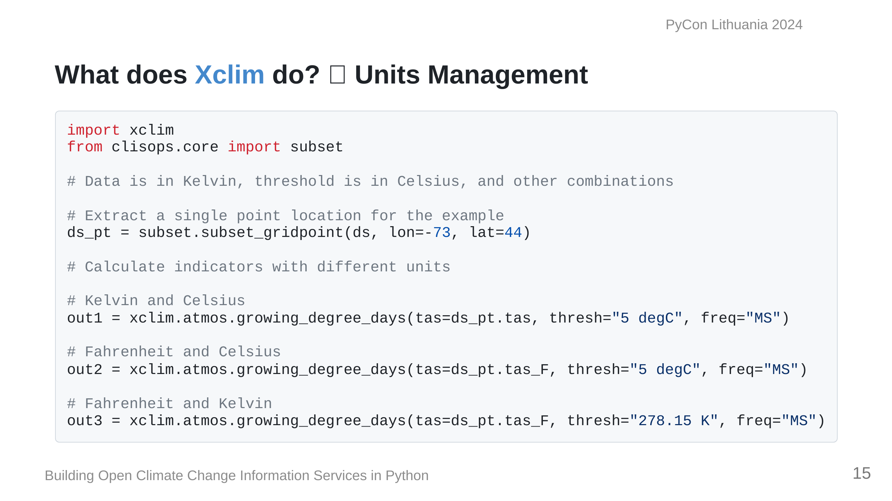

Slide 16
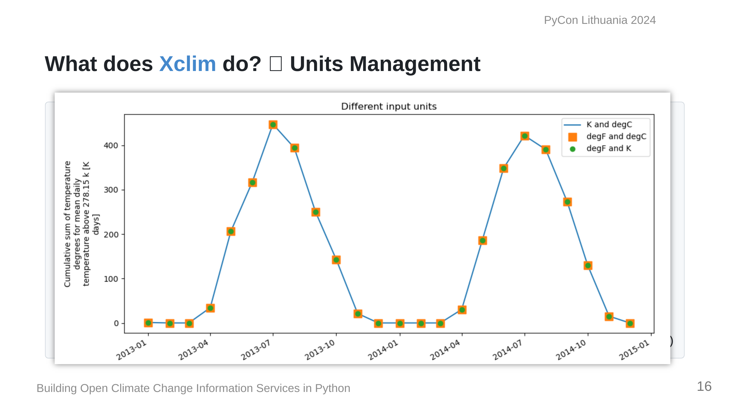

Slide 17
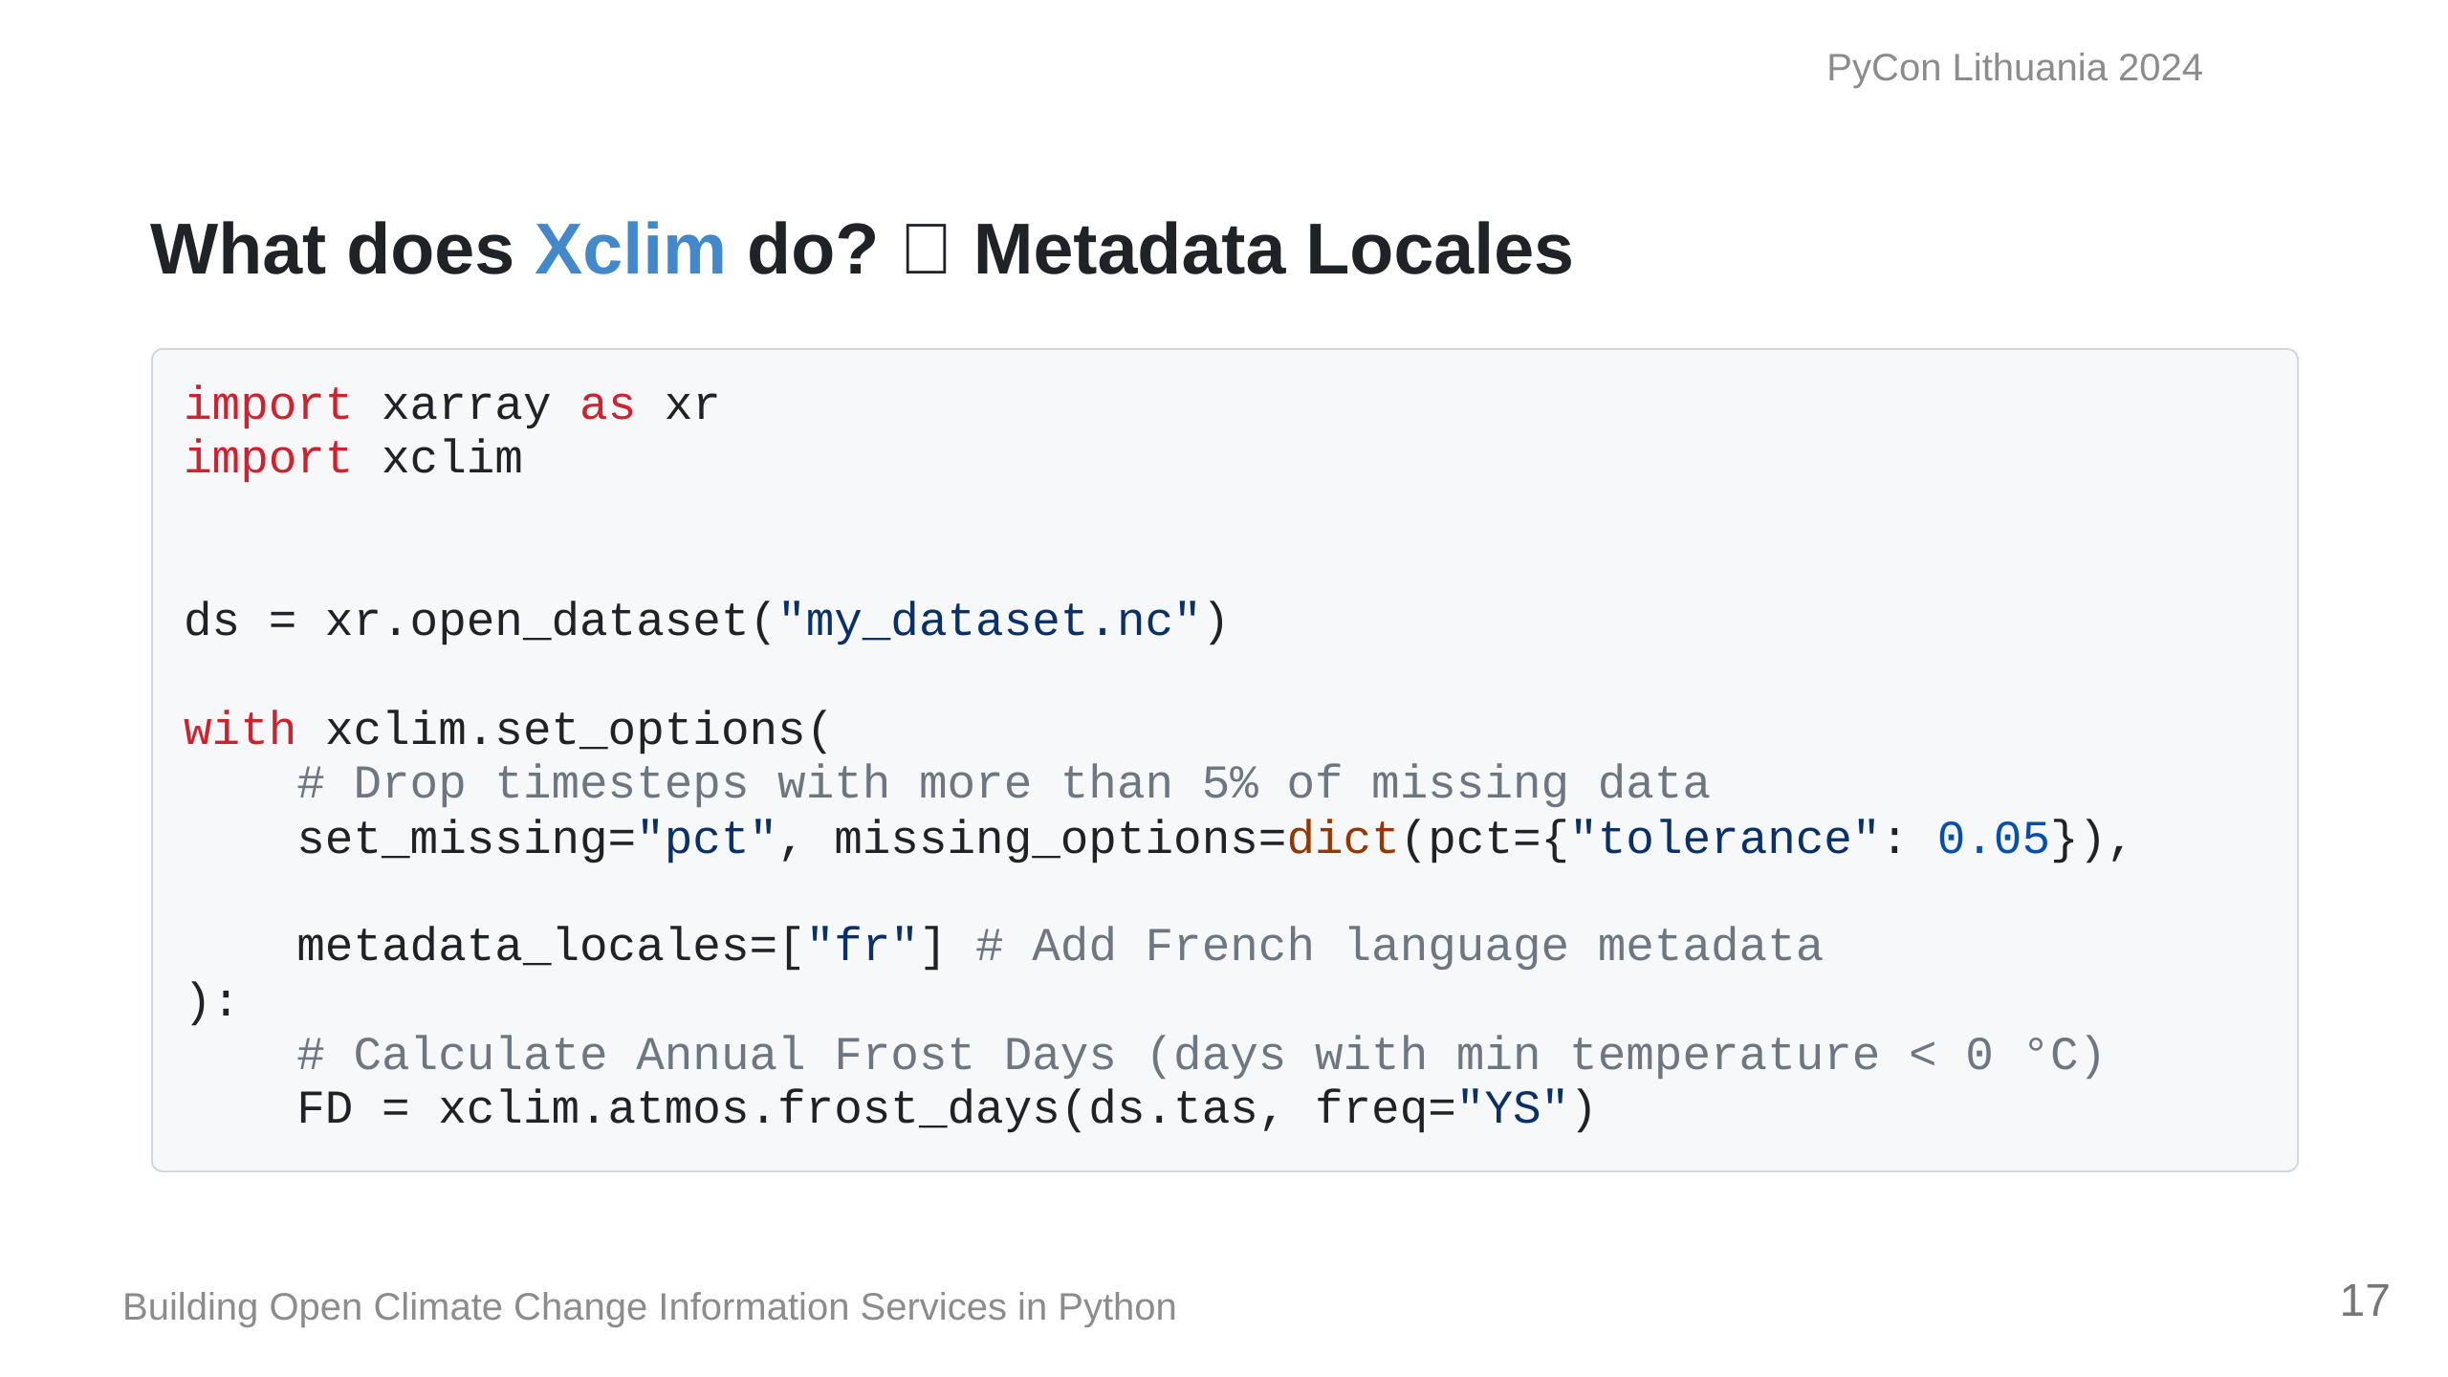
Notes:
`xclim` also has the ability to

Slide 18
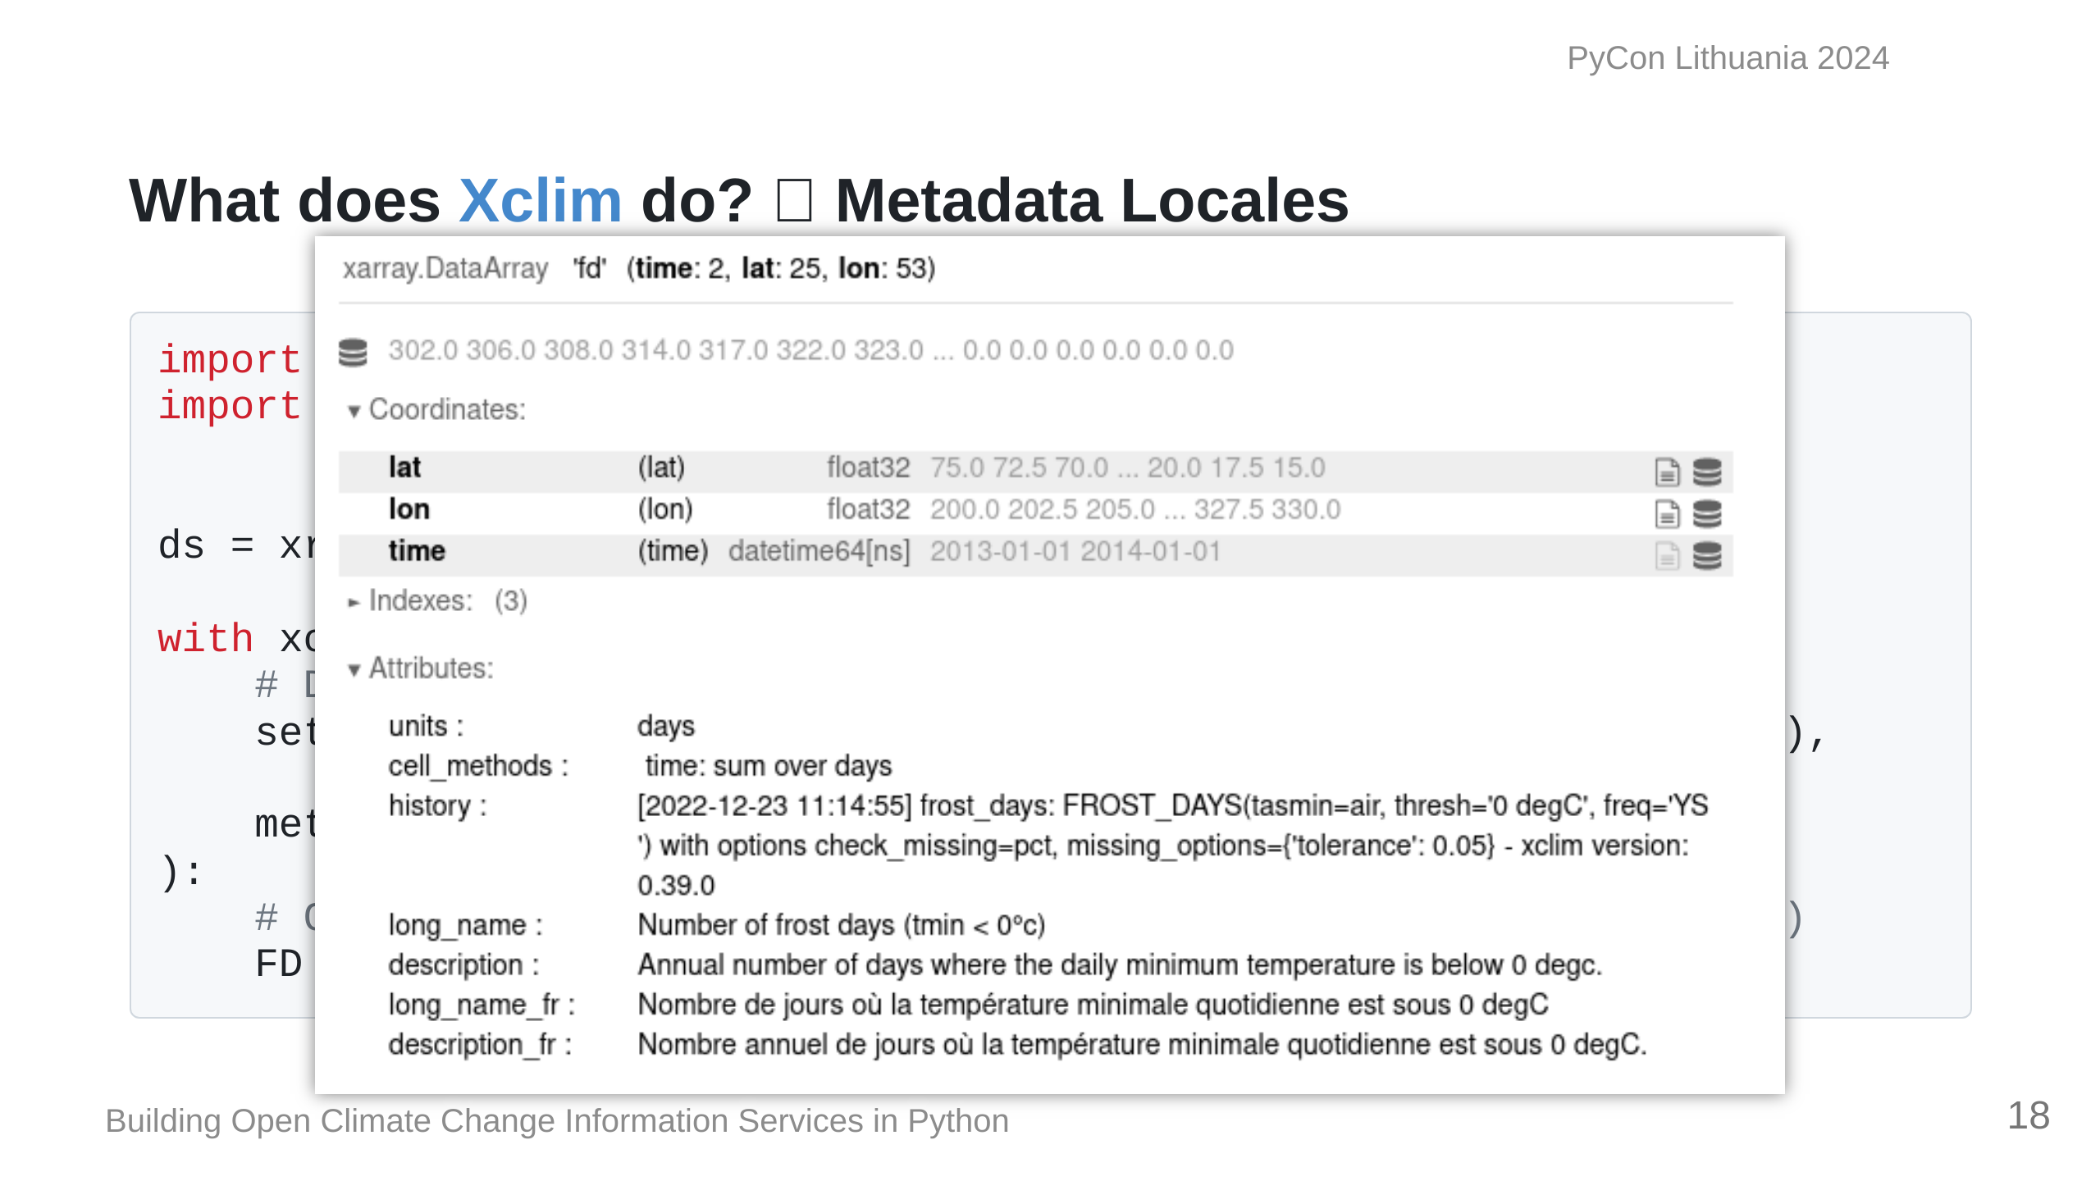

Slide 19
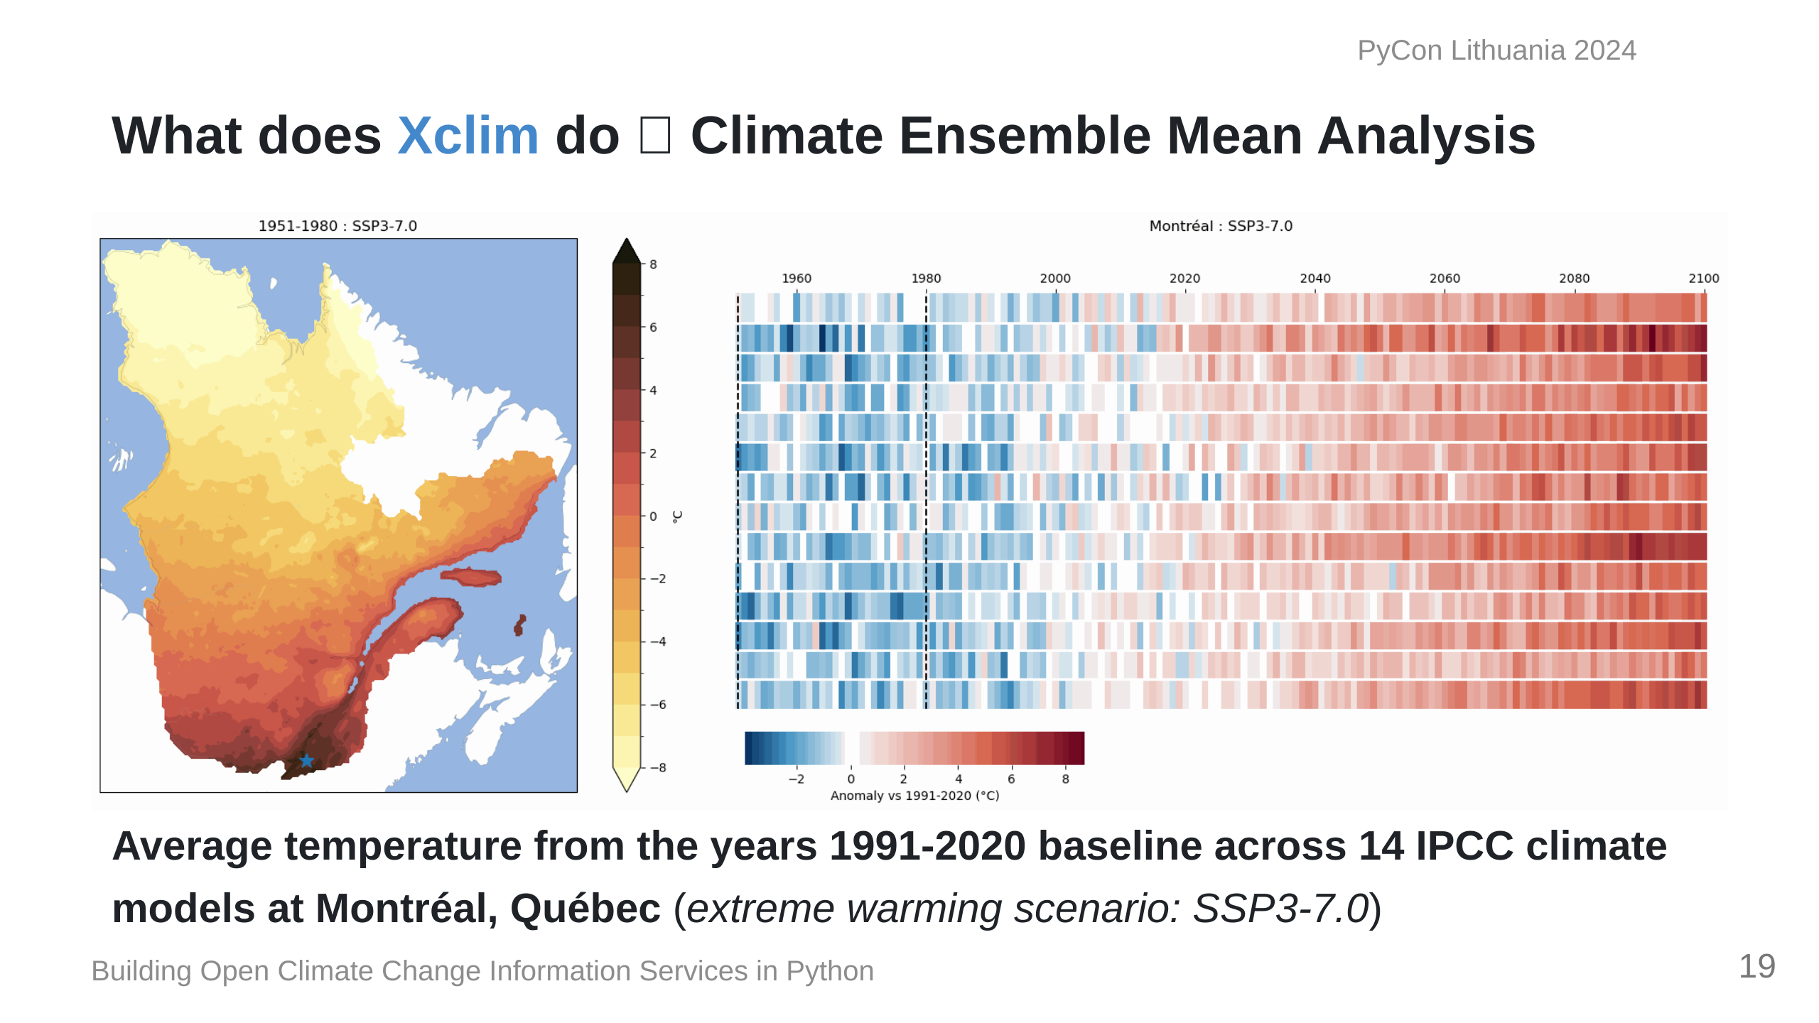
Notes:
This is an example of what we can calculate with `Xclim`; Here we have data from 14 climate models. On the left is the average annual temperature for the province of Quebec, while on the right is the average change from a 1990-2020 baseline across the 14 models.

Slide 20
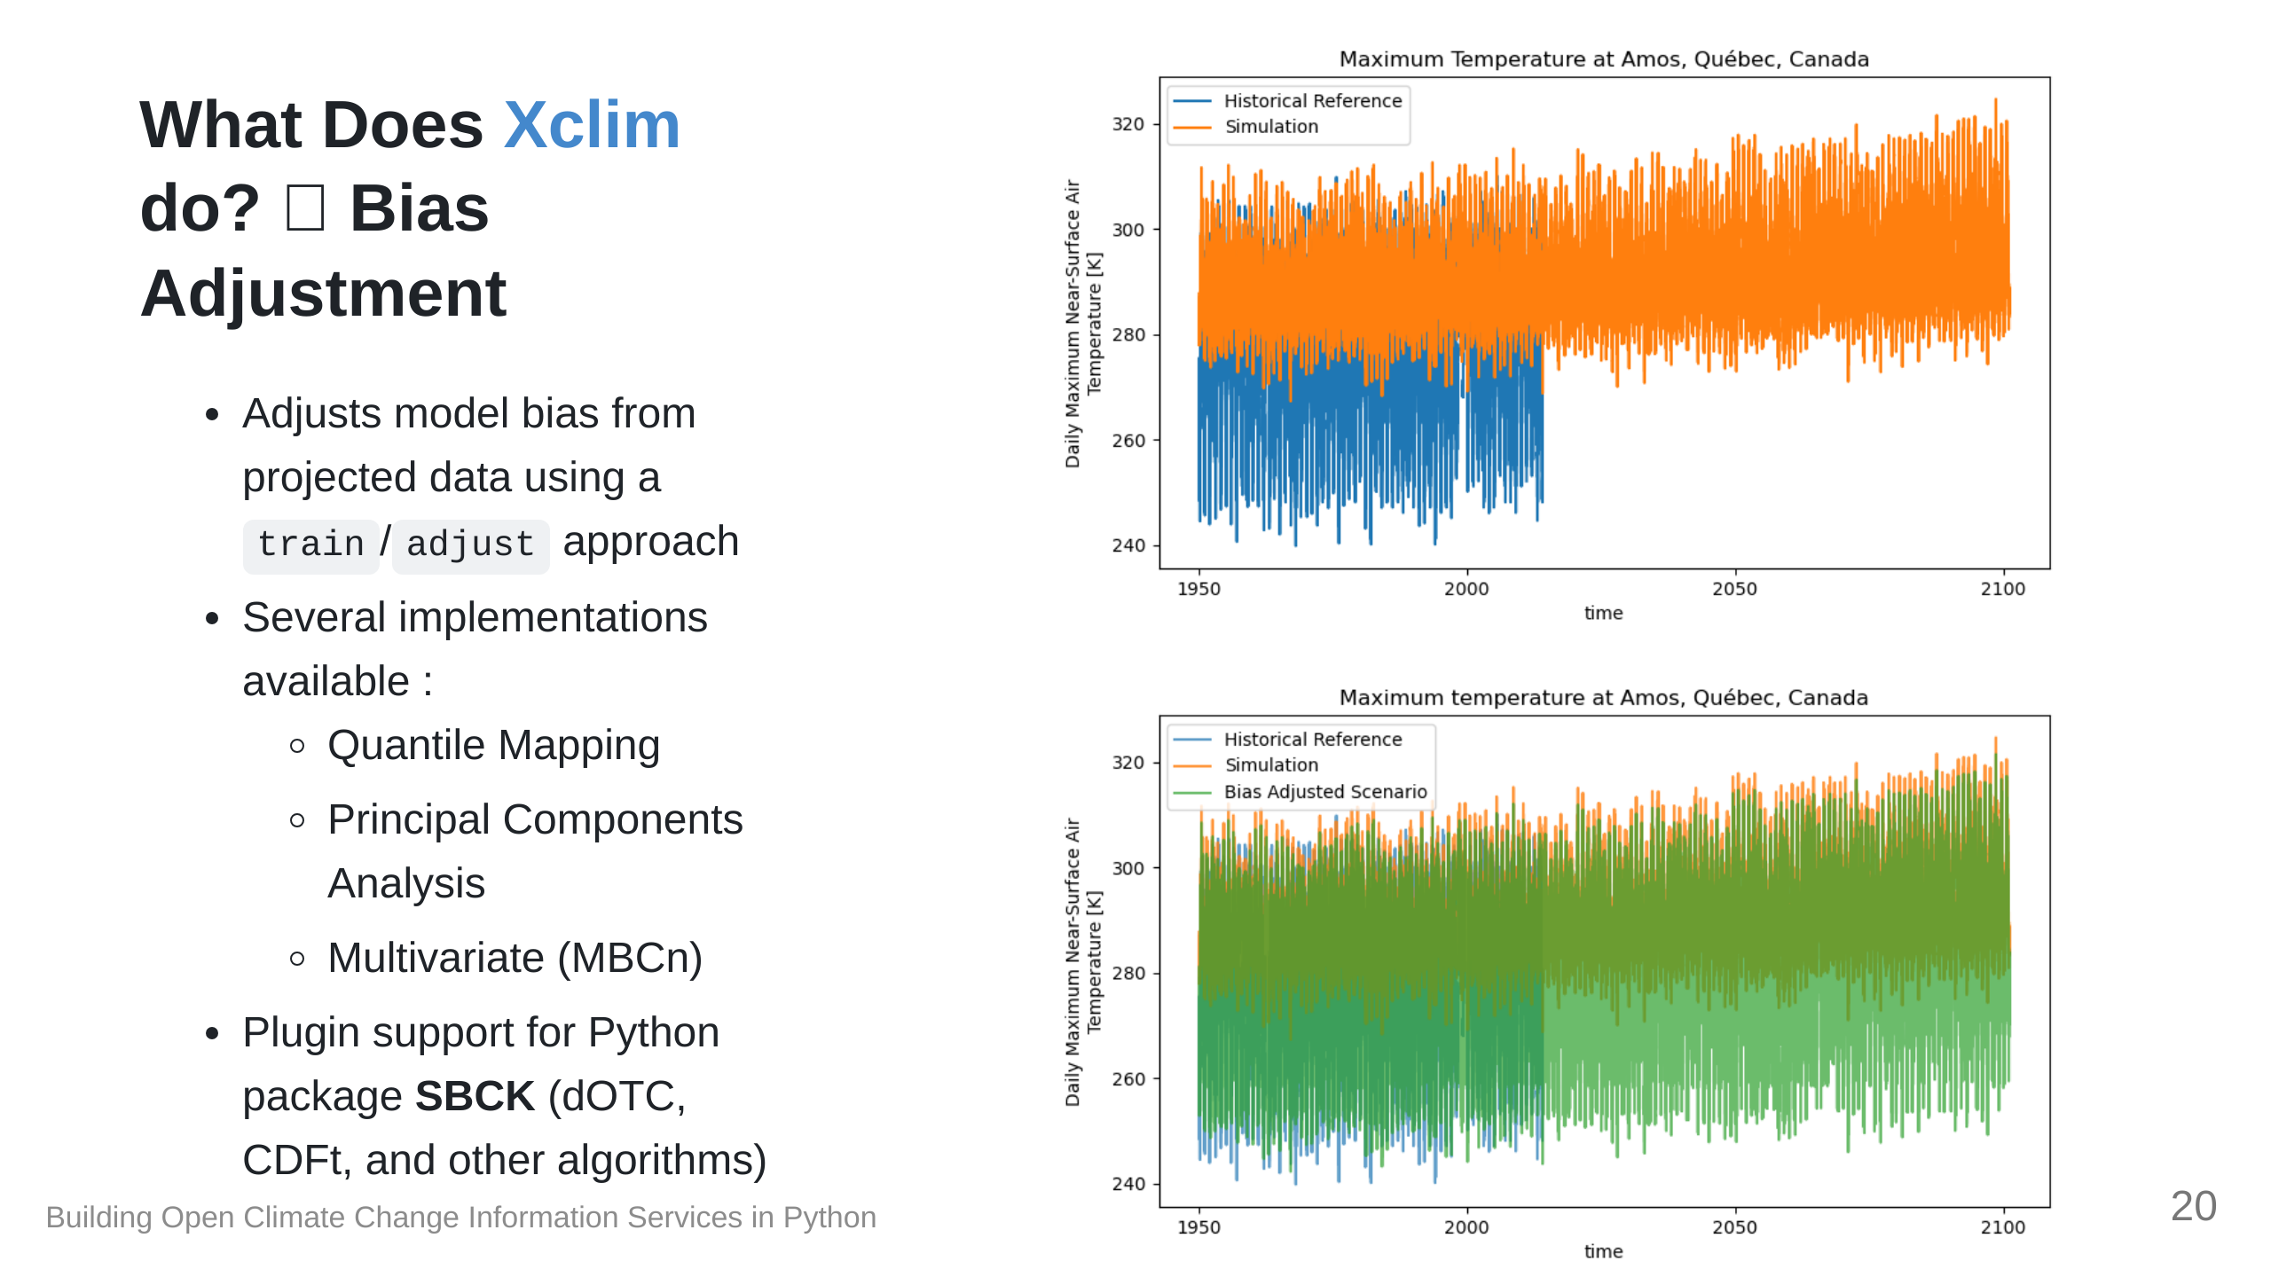

Slide 21
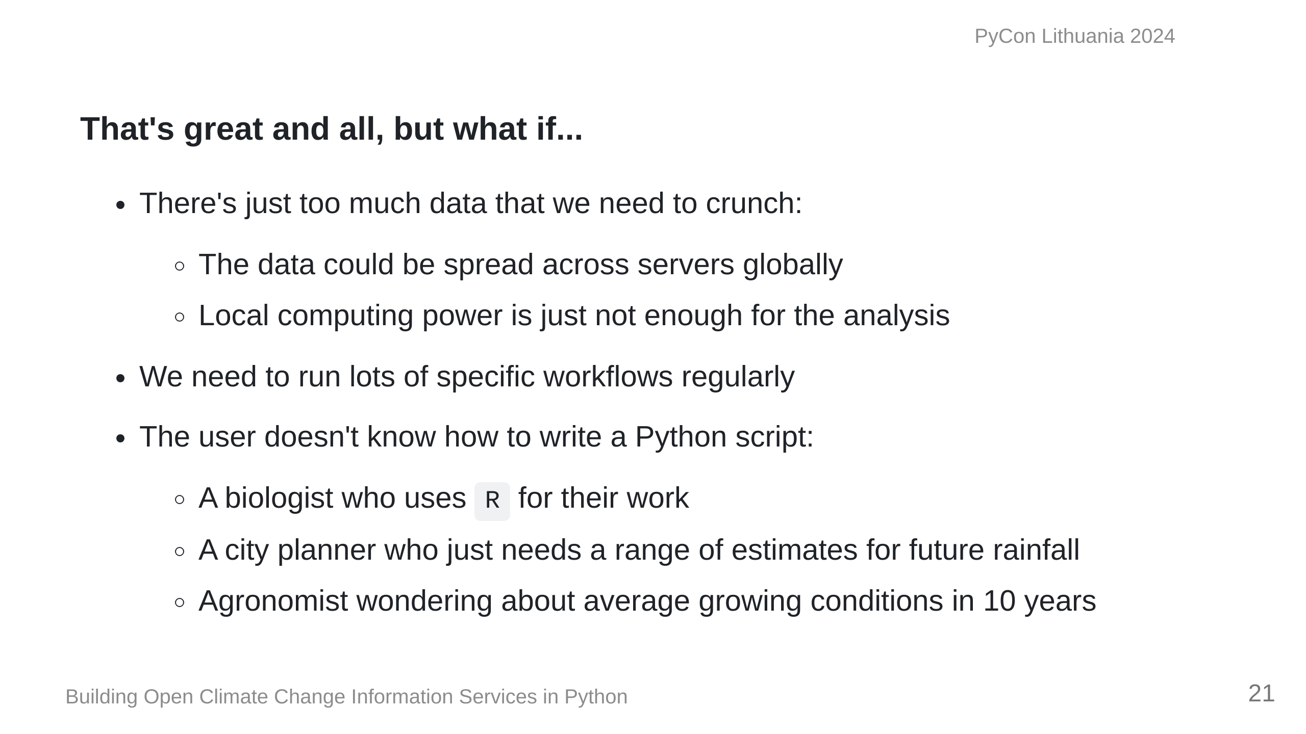

Slide 22


Slide 23
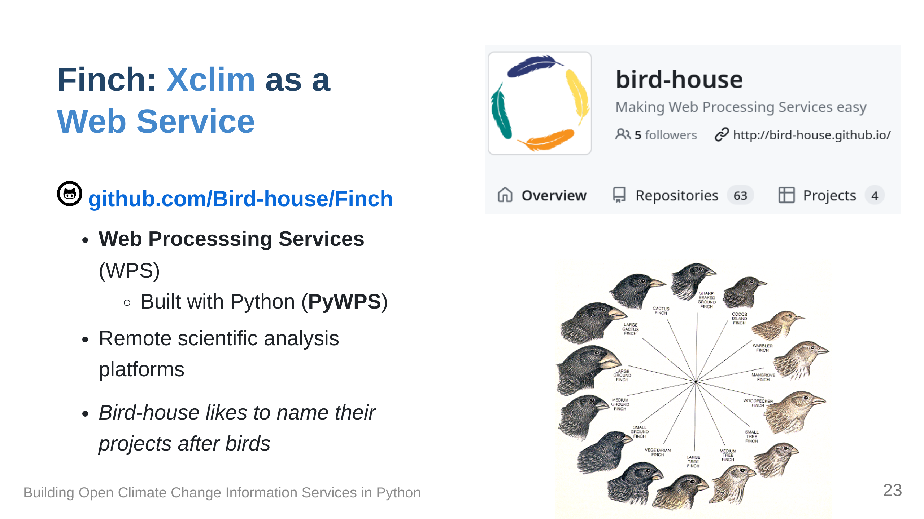

Slide 24
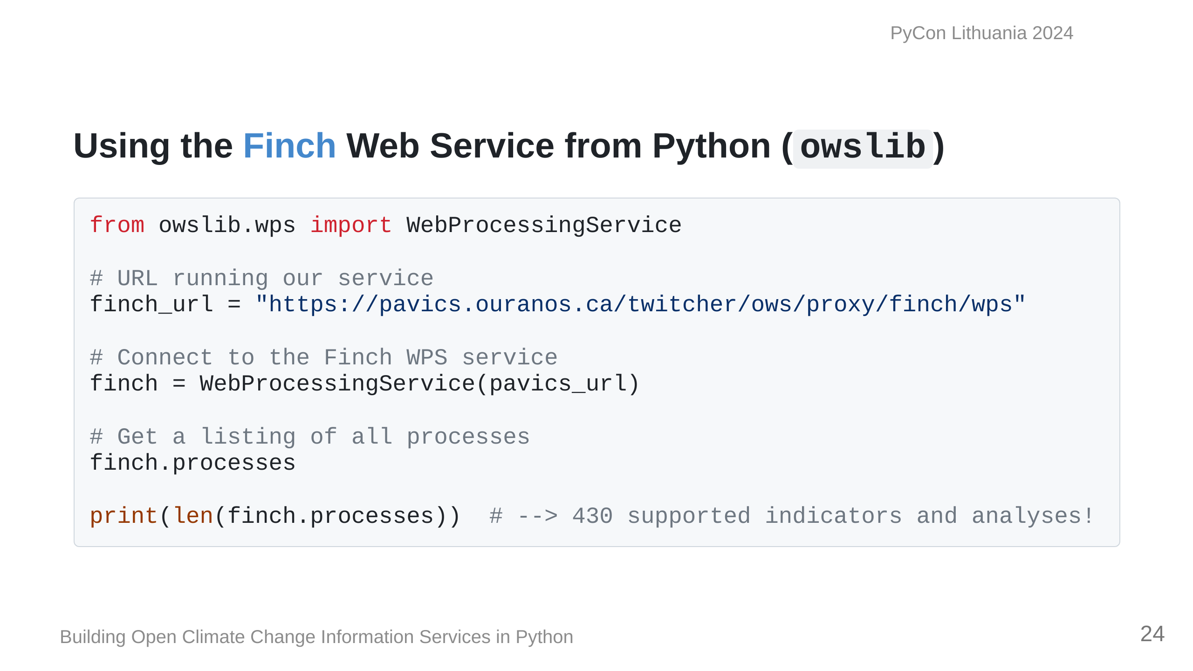

Slide 25
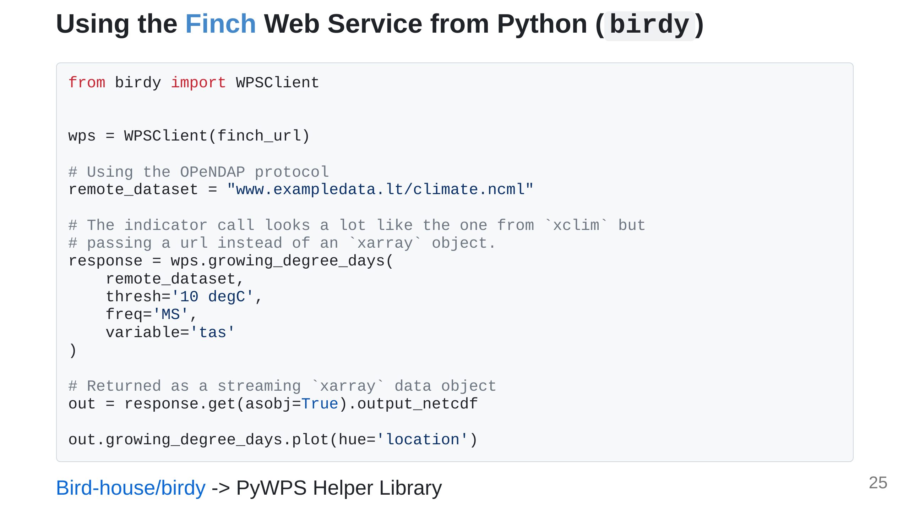

Slide 26
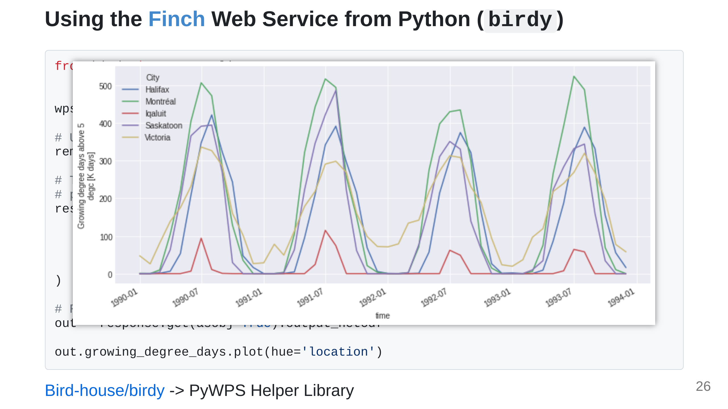

Slide 27
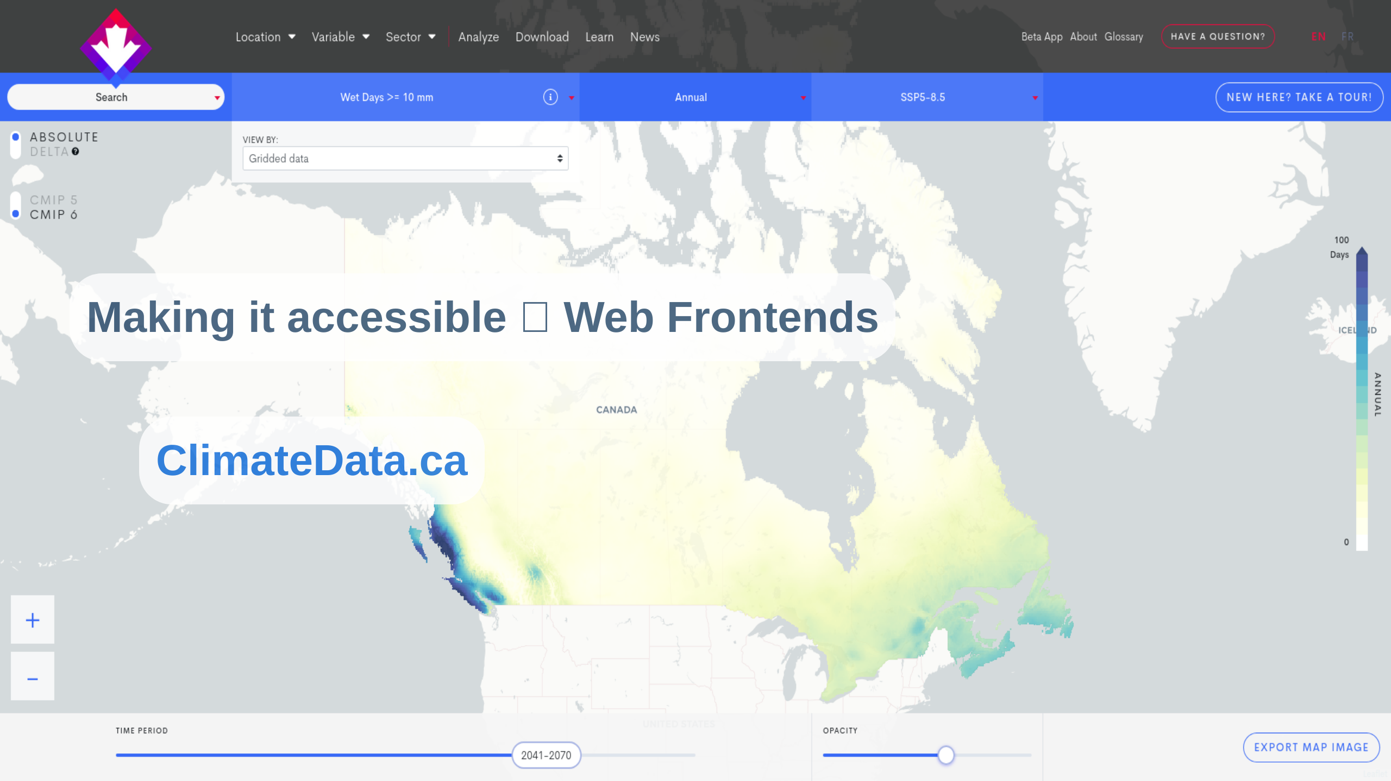

Slide 28
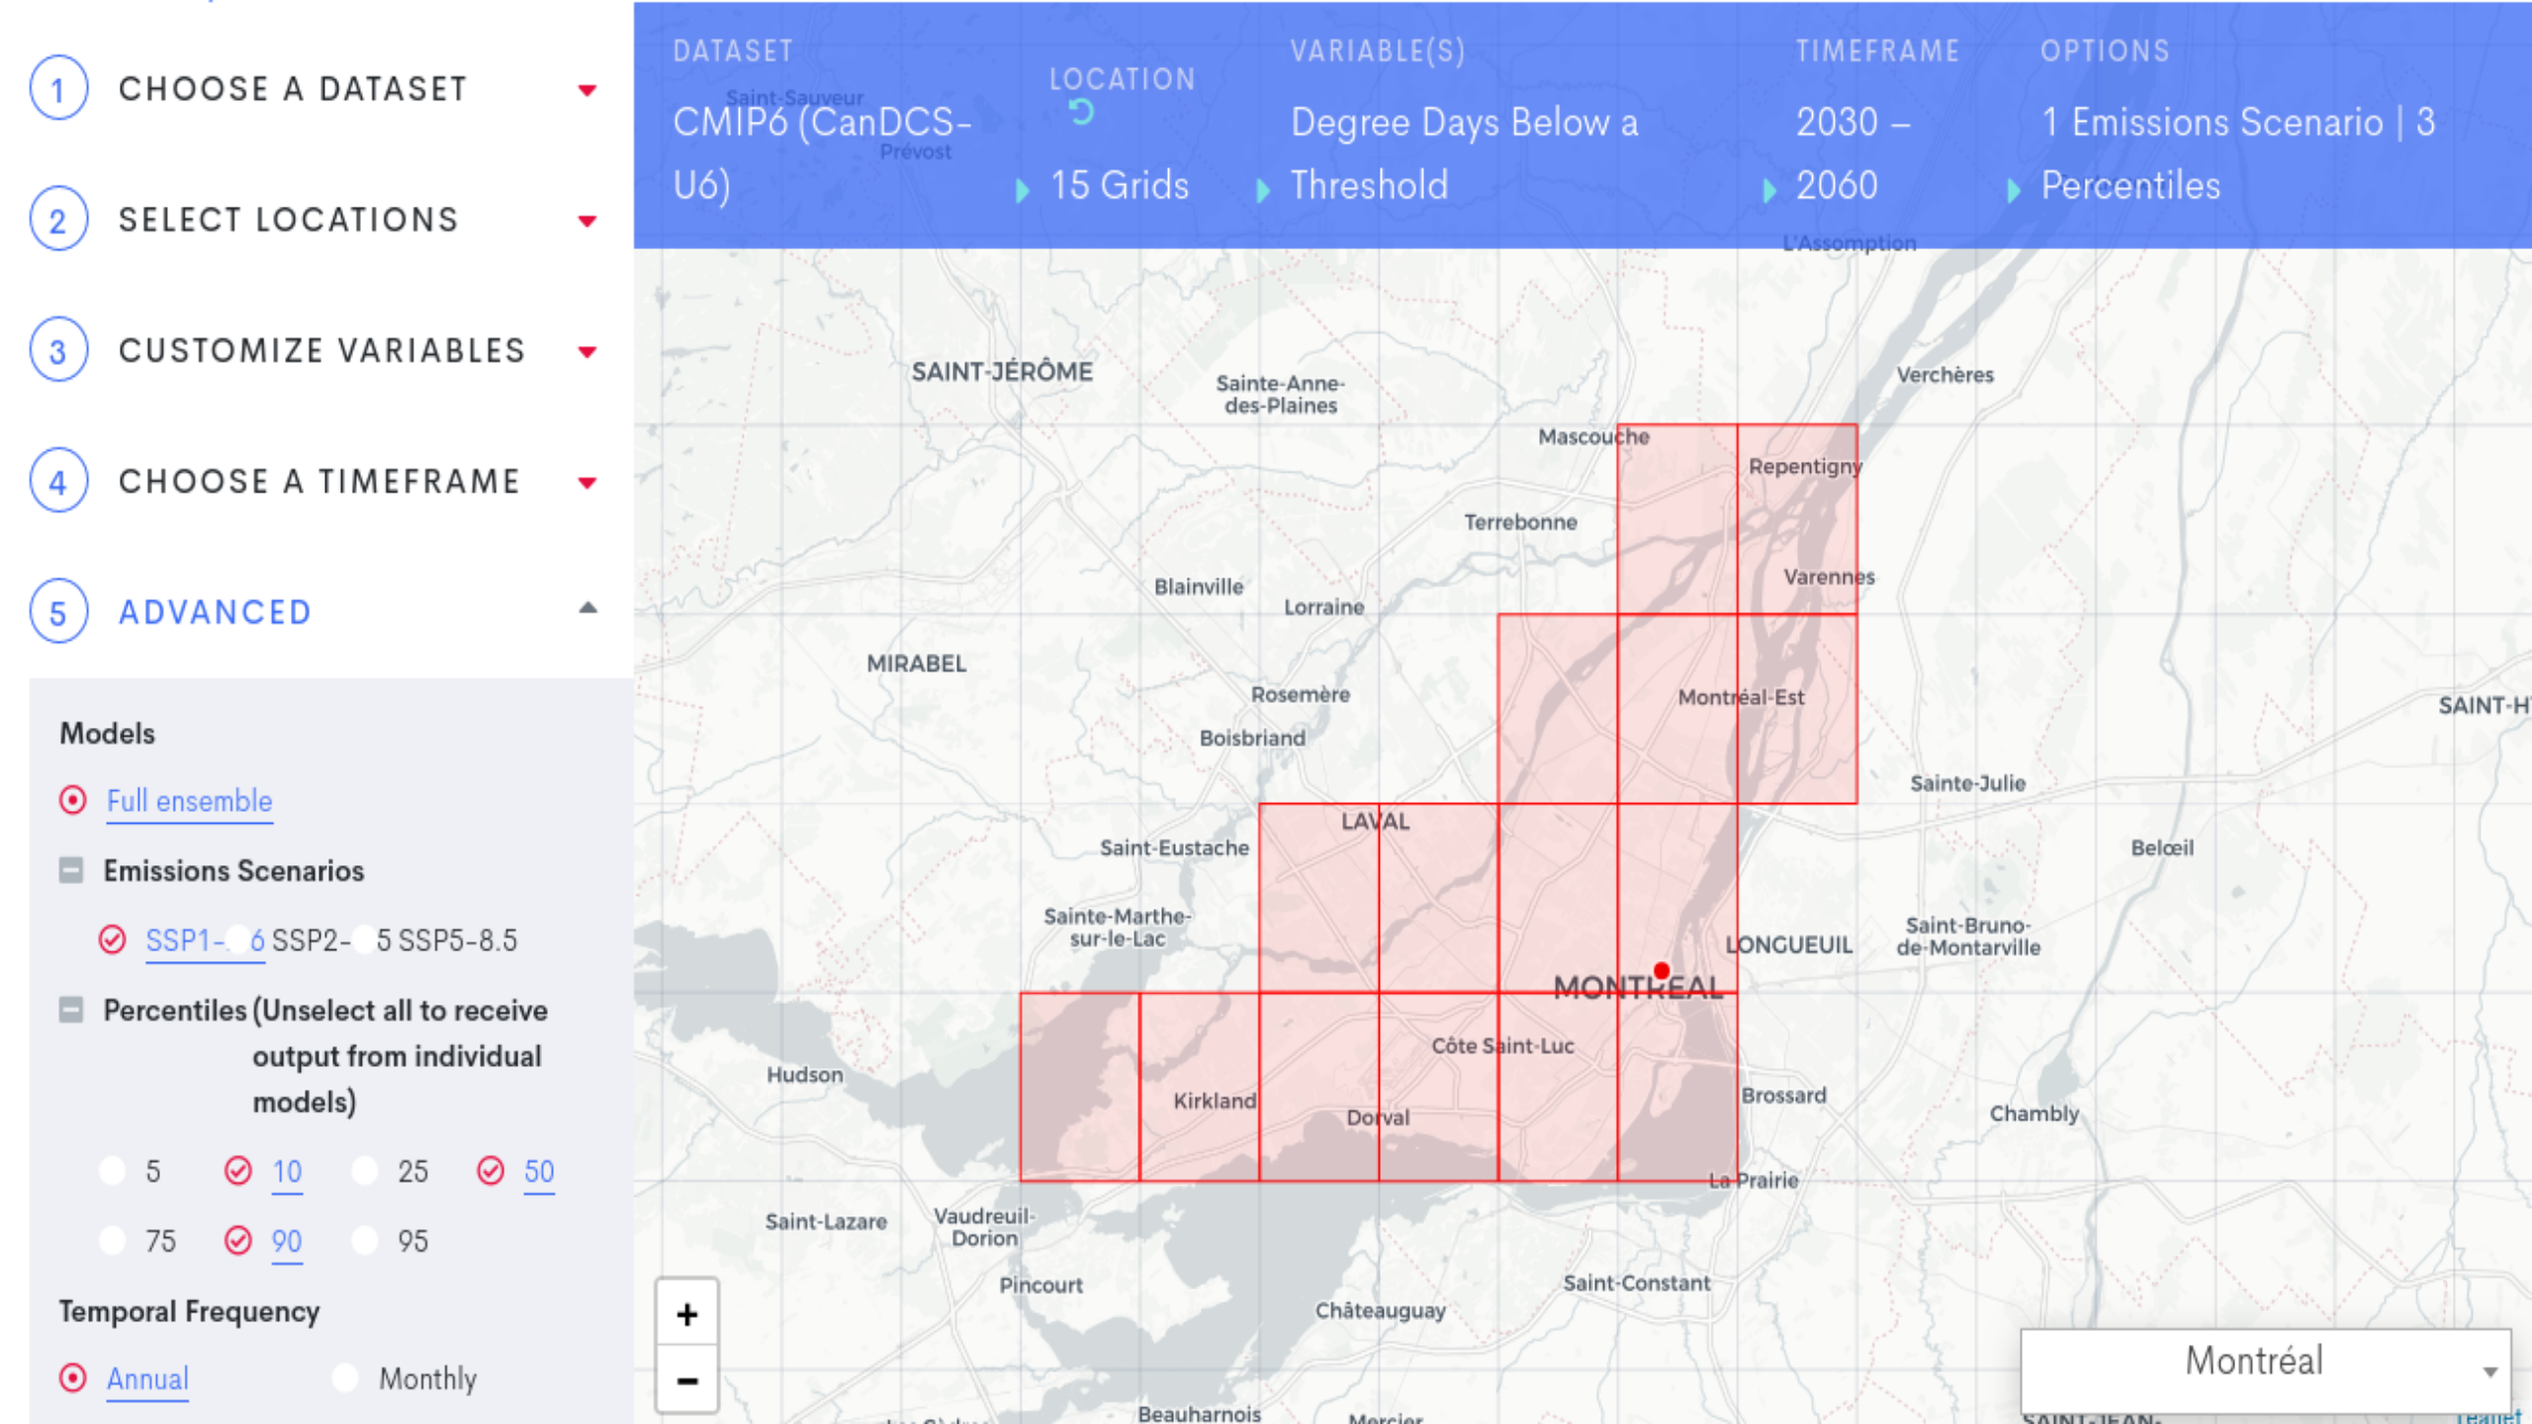

Slide 29
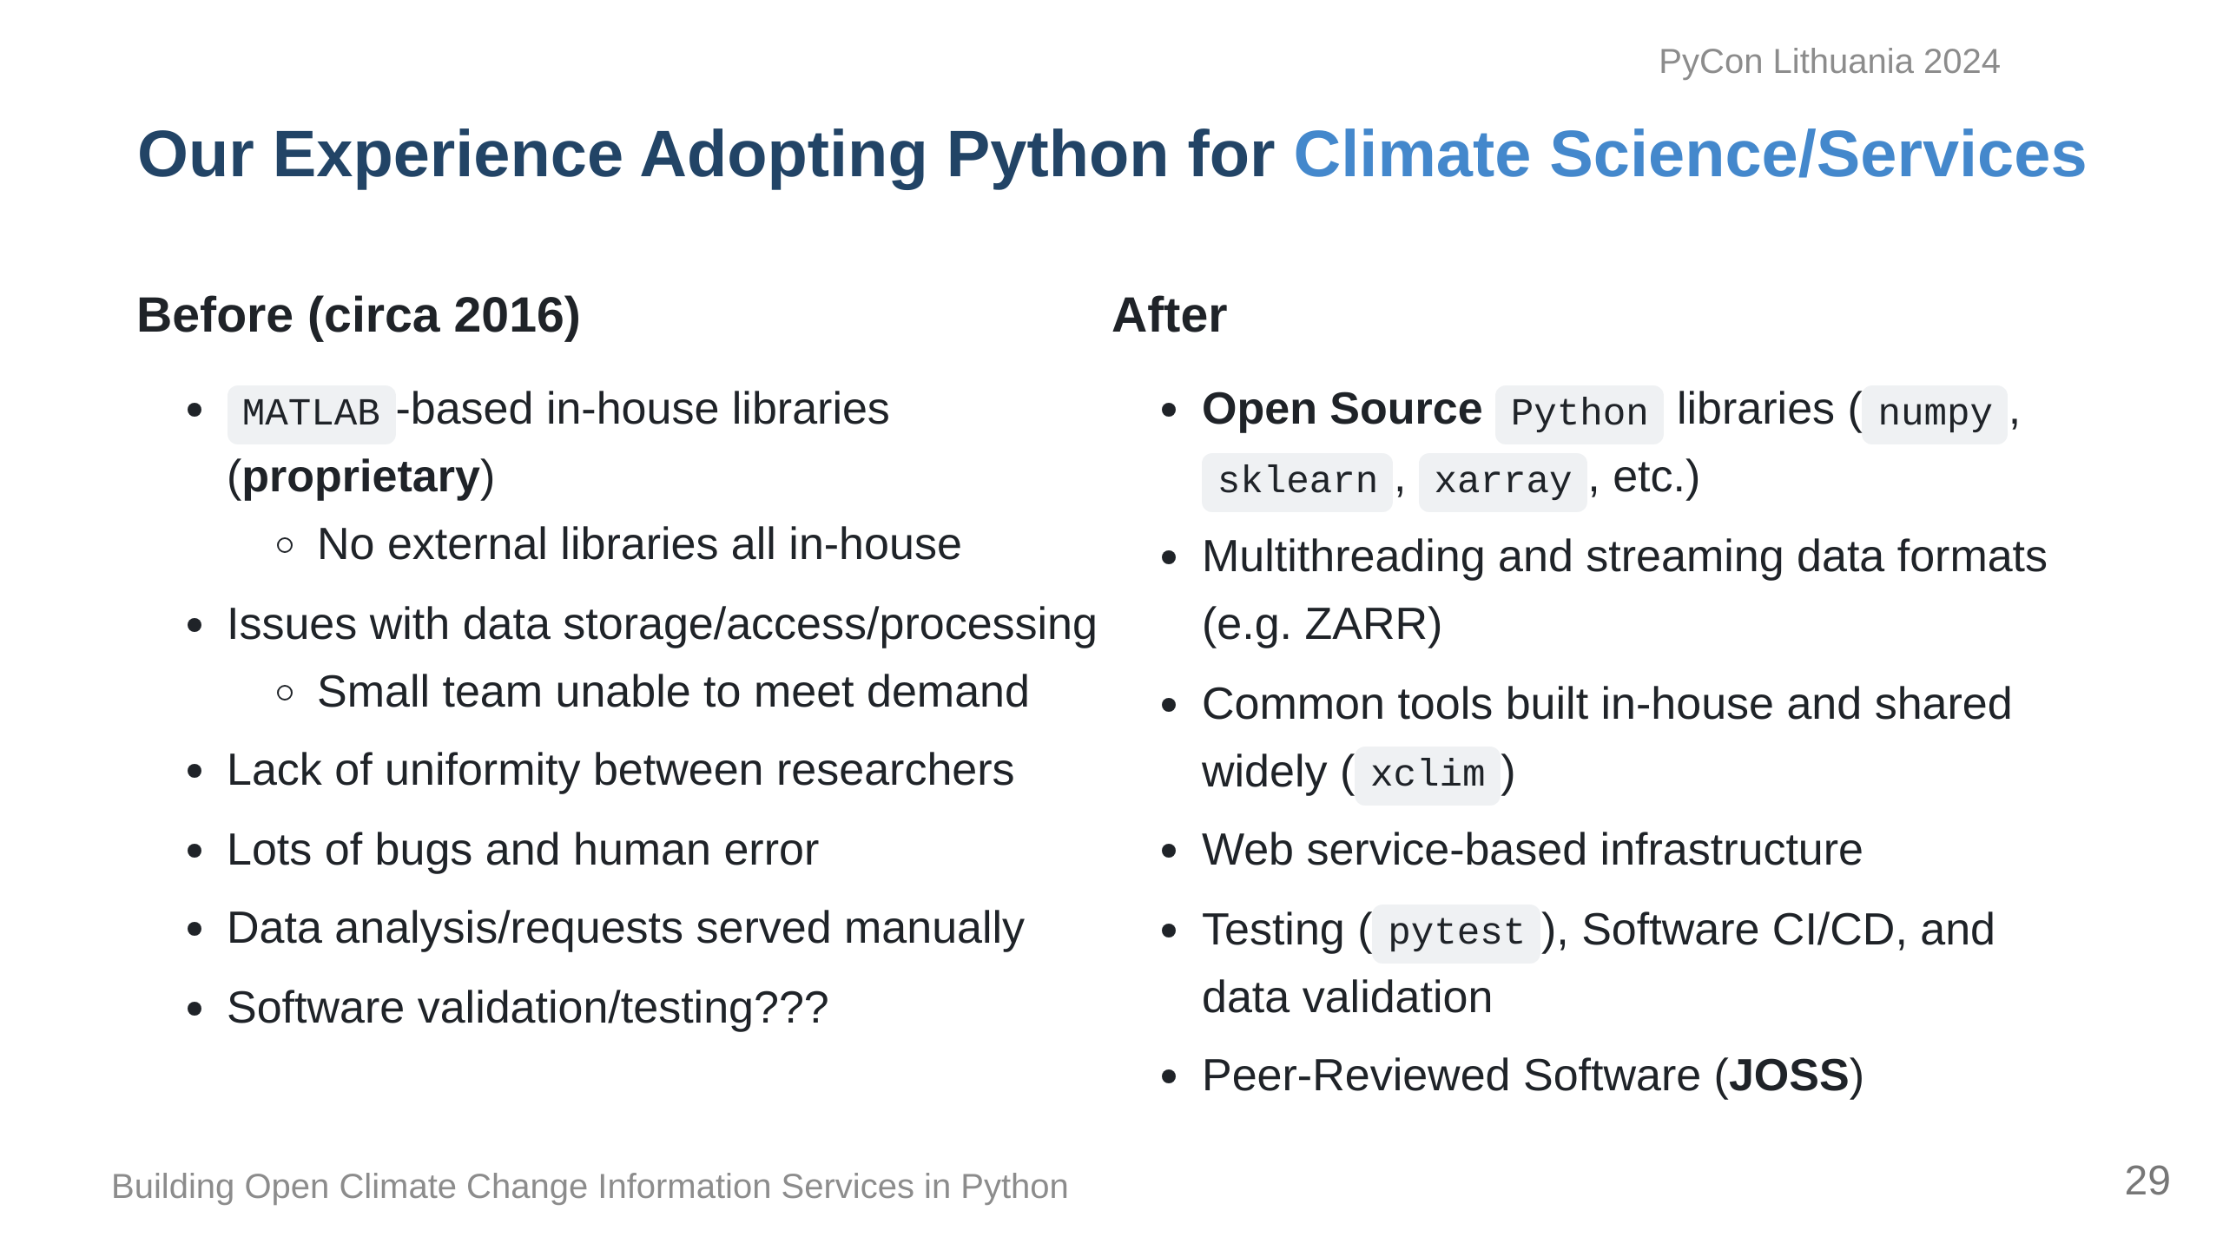

Slide 30
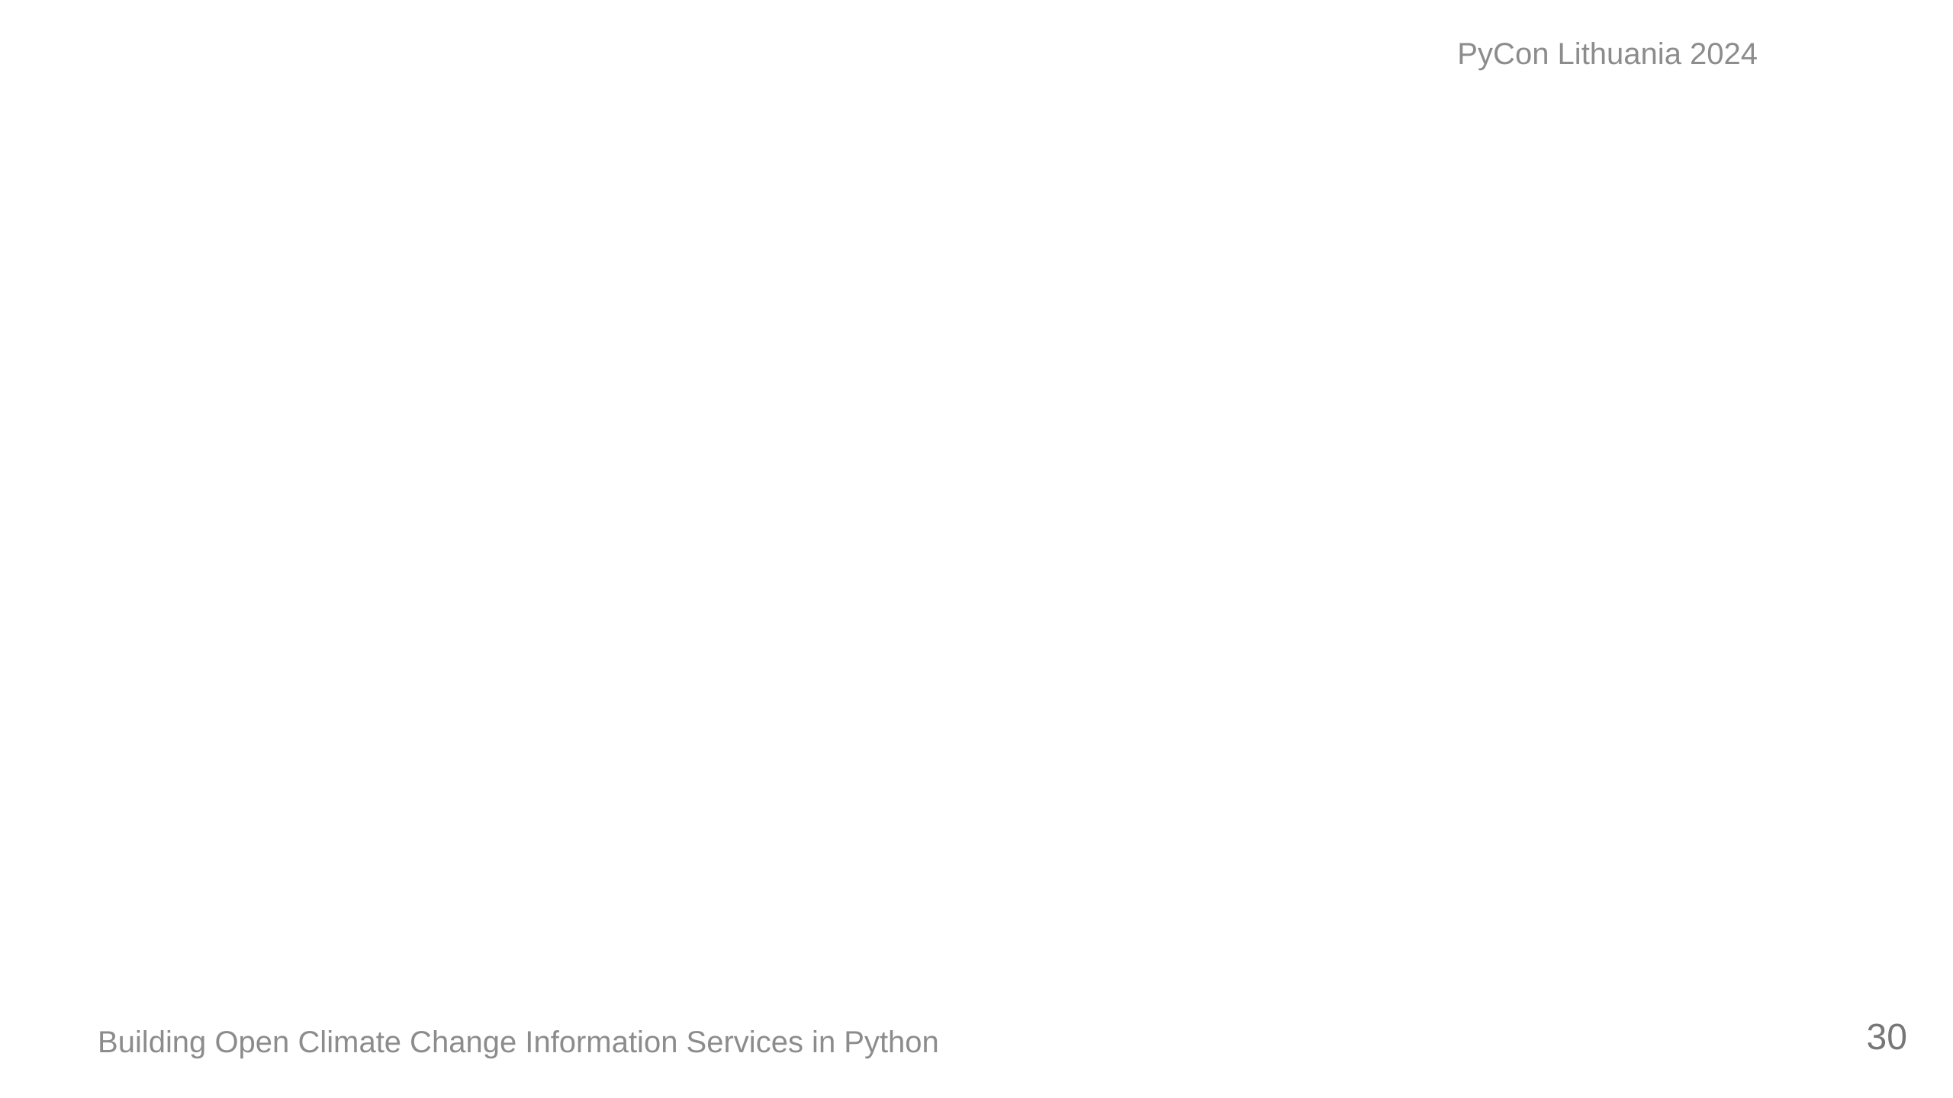

Slide 31
